Slide 1
Systematic Biology
Big Data
Machine Learning

Slide 2
Background
What is Big Data
What is Machine Learning
What is Deep Learning
Tools for application
Data preparation

Slide 3
Big Data
Micro
Analysis
Massive information
Genome Epigenome
Biological process
Phenomenon Pathology
Personalized Treatment
More Accessible Data Storage
New Sequencing Technology
Macro
Analysis

Slide 4
Machine learning
Unsupervised
Learning
Support Vector Machine
Statistics
Regression
Neural Network
Tree Forest
Clustering
Dimensional Reduction
Supervised
Learning

Slide 5
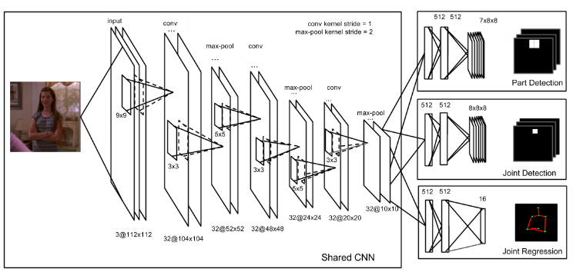



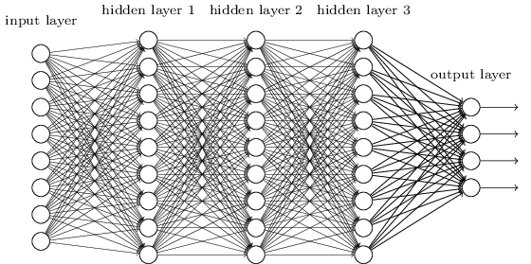
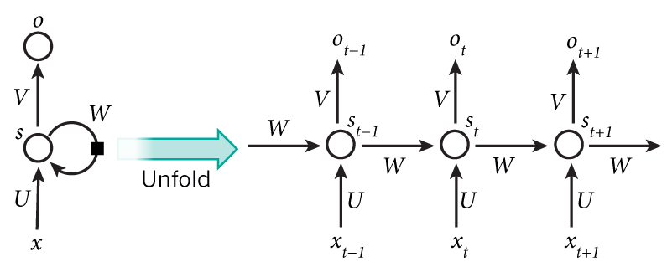
Deep Learning
Dig Deeper
“If you gaze long into the abyss, the abyss also gazes into you”
by Friedrich Nietzsche
Long
Short-term
Memory
(LSTM)
Convolutional
Neural
Network
(CNN)
Recurrent
Neural
network
(RNN)
Multilayer
Perceptron
(DNN)
Geoffrey
Hinton
Yann
LeCun
Yoshua
Bengio

Slide 6
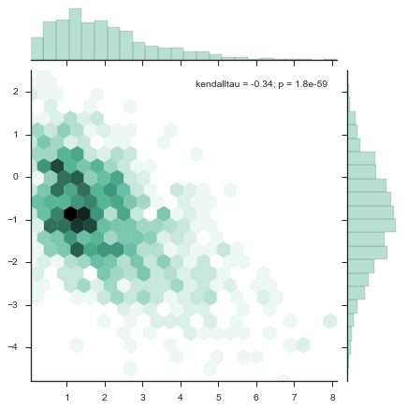
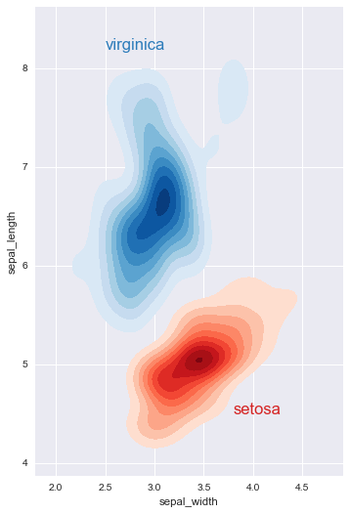
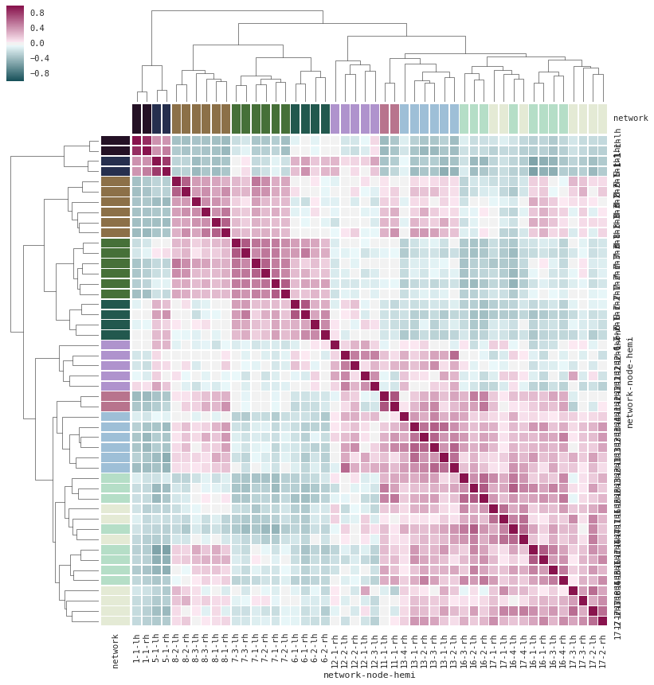
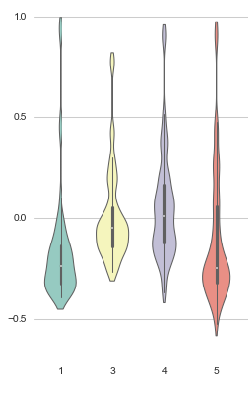
Convenient to use
1. Python:
Matrix and operation: NUMPY, SCIPY
Data frame: PANDAS
Machine learning: SKLEARN
Deep learning: THEANO, KARAS
Visualization: MATPLOTLIB, SEABORN
2. R packages:
Classification, regression and tree:
RPART, PARTY, CARET
Forest: randomForest
Neural Network: NNET
Support vector machine, Naïve Bayes: e1071
Visualization: ggplot

Slide 7
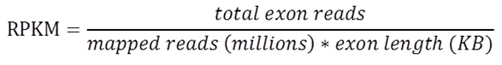
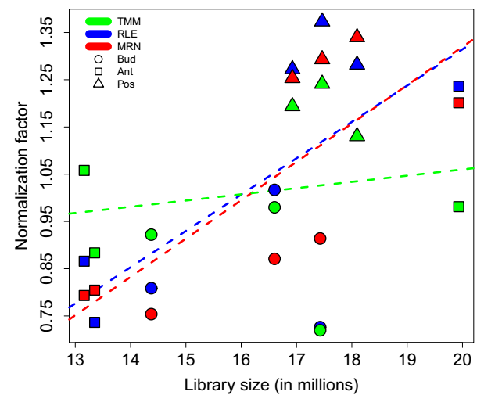

Data normalization
Reads/Fragments Per Kilobase per Million (RPKM/FPKM)
Relative Log Expression (RLE, DESeq2)
Trimmed mean of M-value (TMM, edgeR)
Median Ration Normalization (MRN)

Slide 8


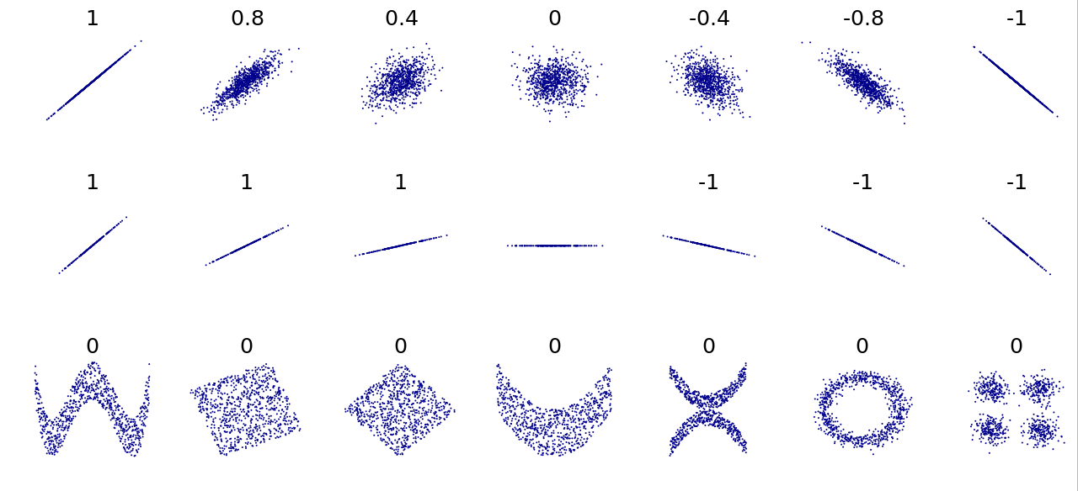
Pearson correlation

Slide 9
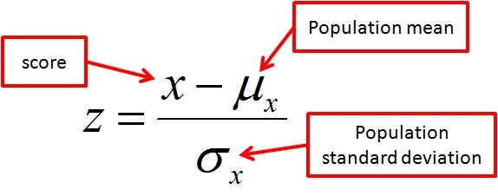
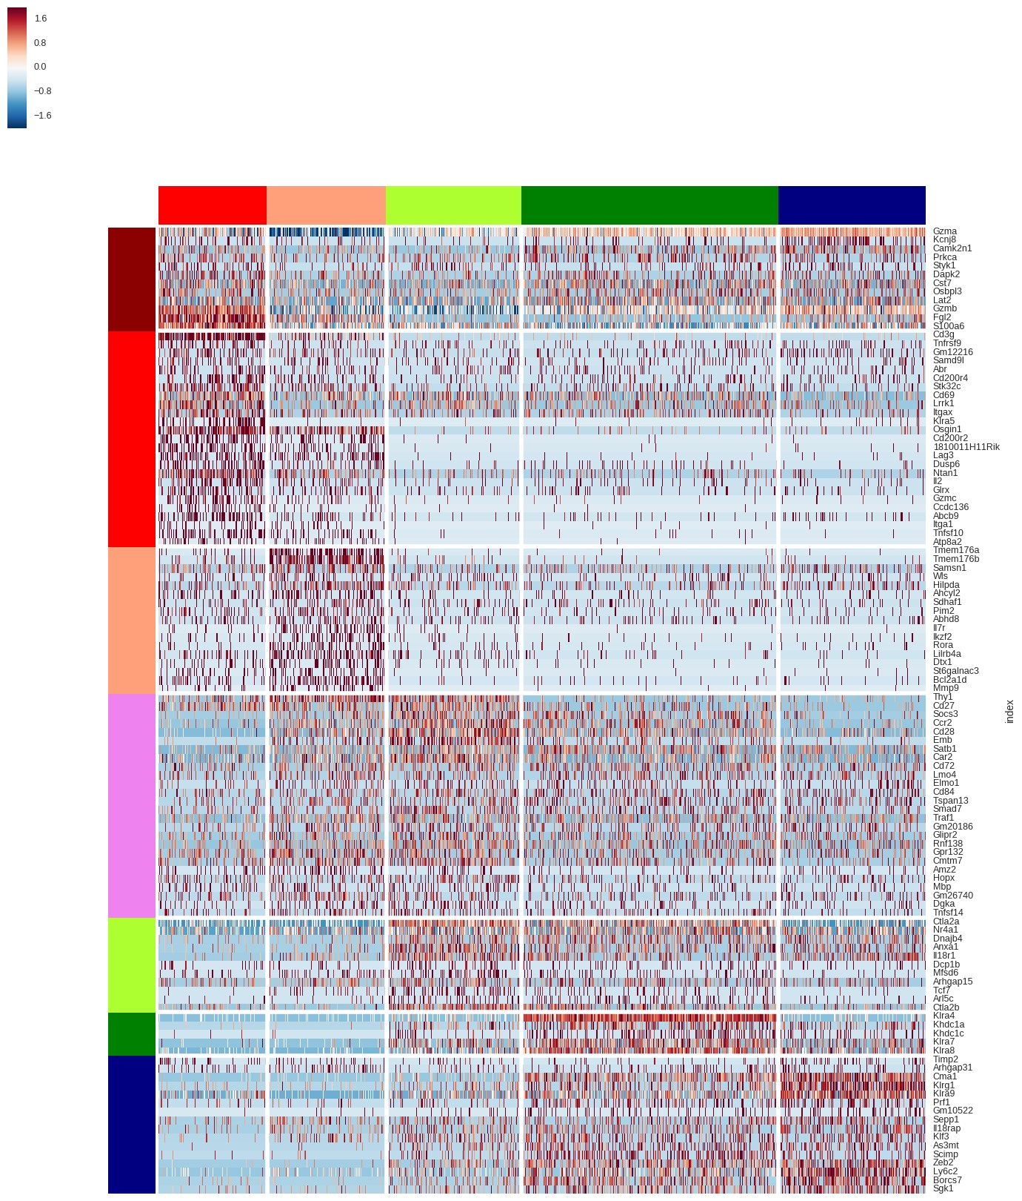
Z-Score

Slide 10
Supervised learning
Linear Regression
Non-linear Regression
Support Vector Machines
Naïve Bayes
Decision Trees and Random Forest
Hidden Markov Model
Neural Network

Slide 11
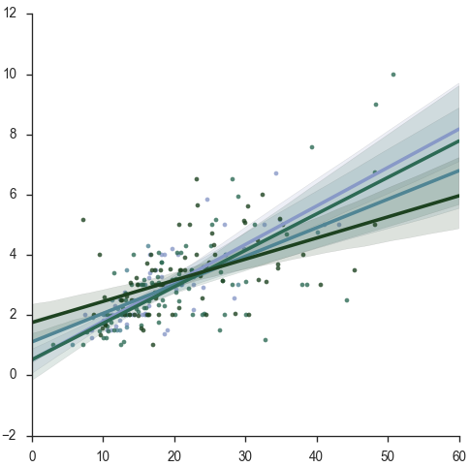


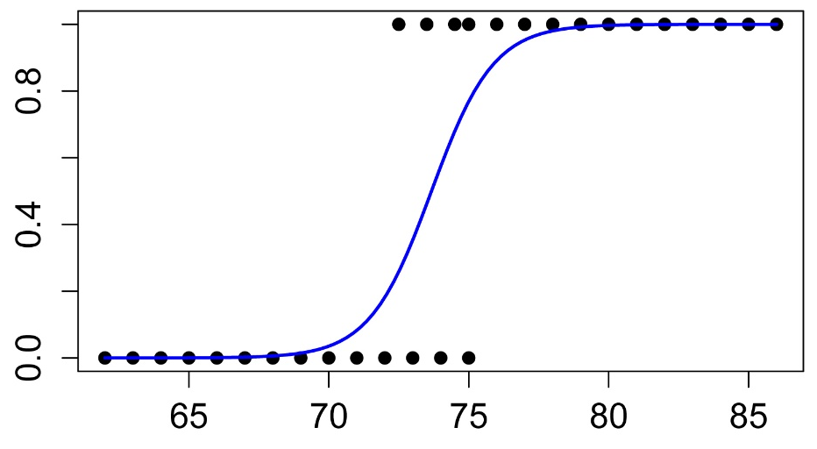

Linear Regression
Least Squares:
Ridge:
Lasso:
Elastic Net:
Bayesian:
Logistic:

Slide 12
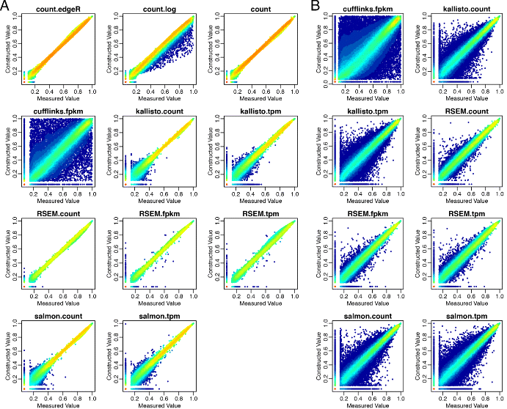
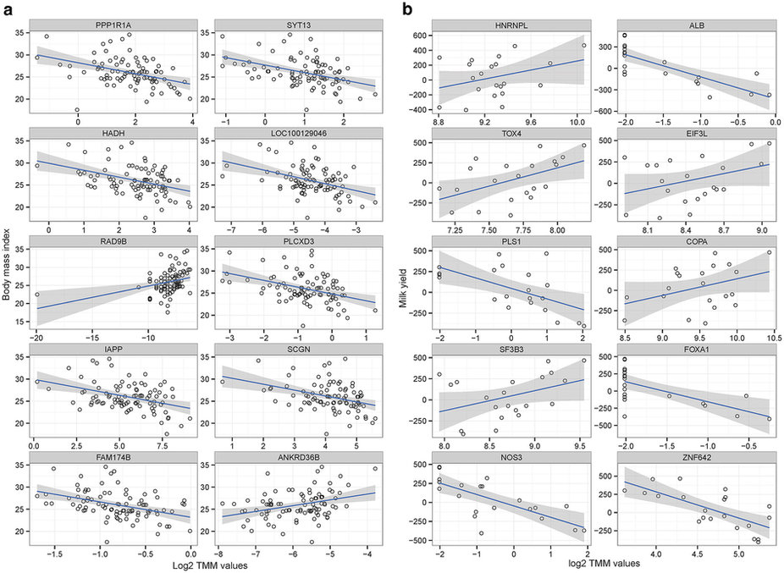
Linear regression: application
Sample comparison & Gene screening
Correlation analysis

Slide 13
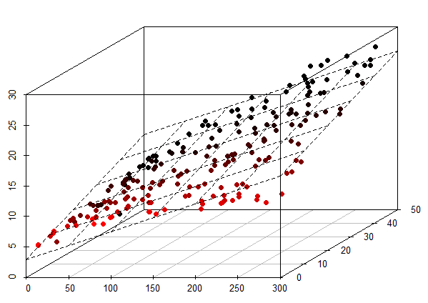
Linear regression: application
High dimension regression

Slide 14
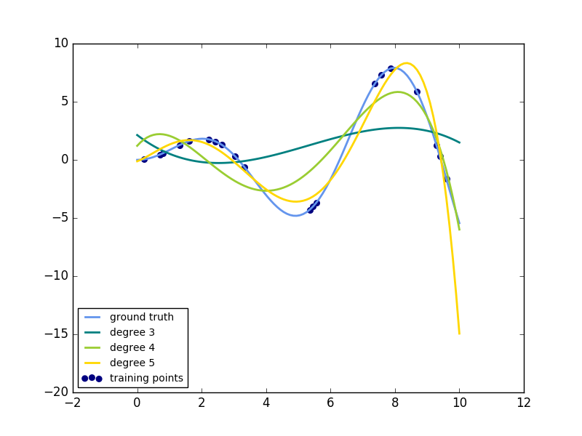
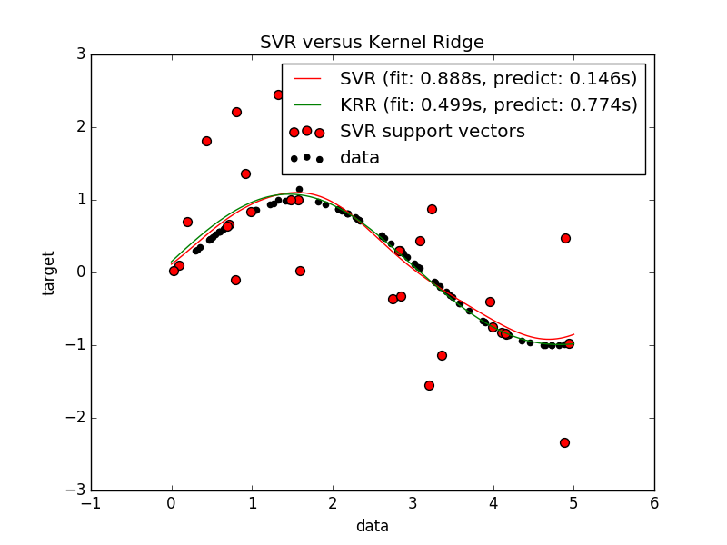
Non-linear regression
Polynomial regression
Kernel ridge regression
Support vector regression

Slide 15
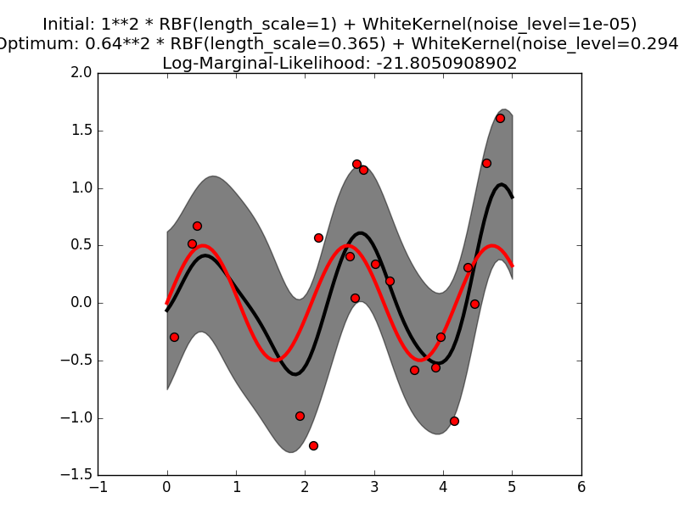

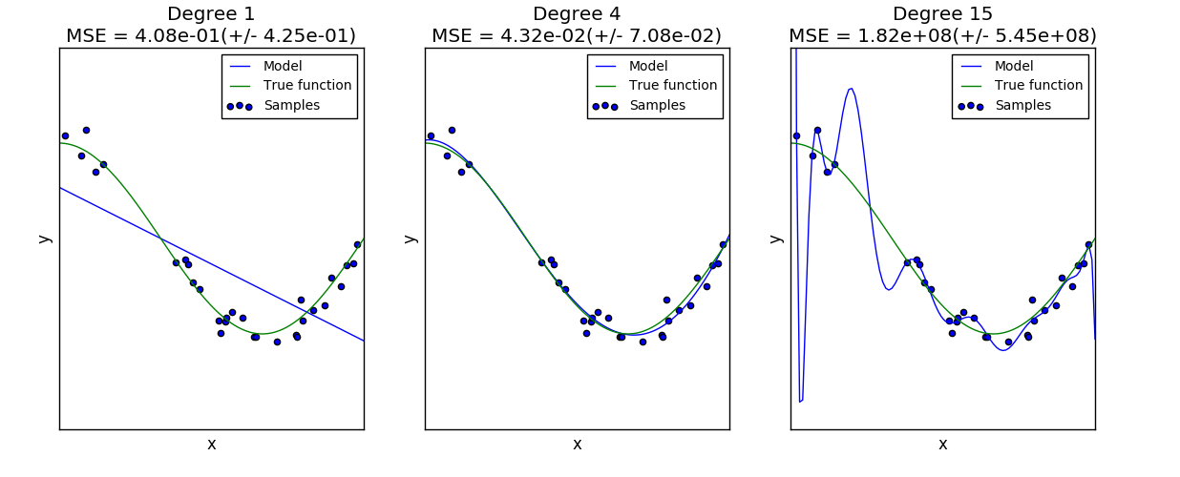
Non-linear regression
Gaussian process regression
Problems:
1. Overfitting
2. Sparse training set
3. Expensive for high dimension

Slide 16
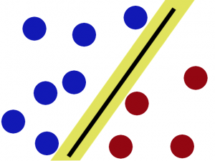
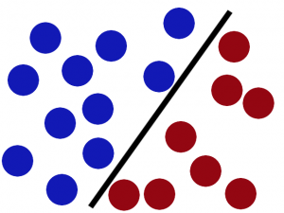
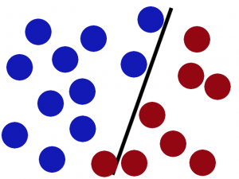
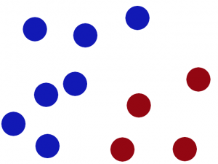
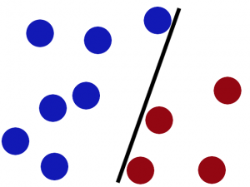
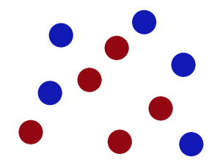
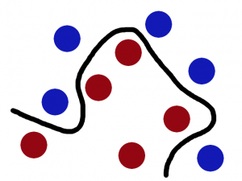
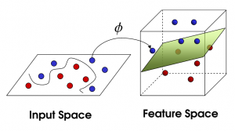
Support Vector Machine

Slide 17
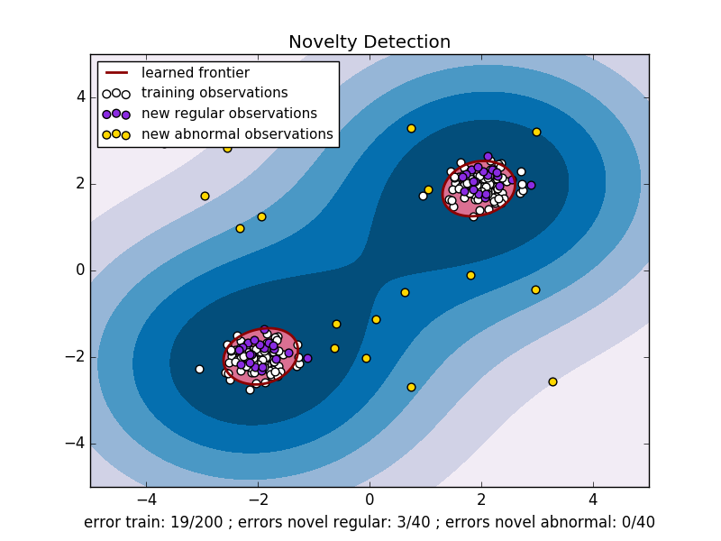
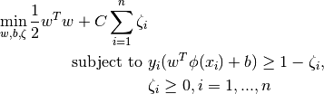
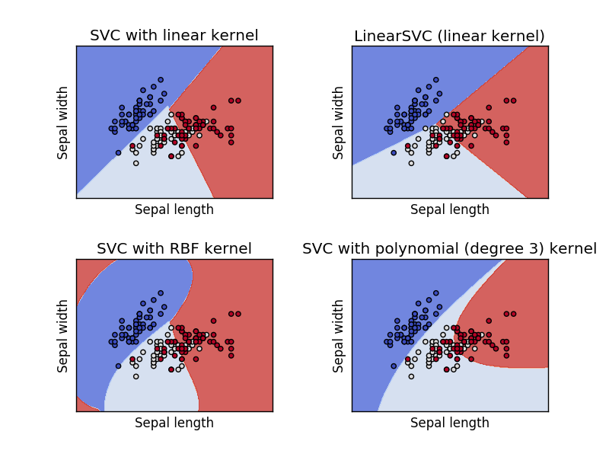
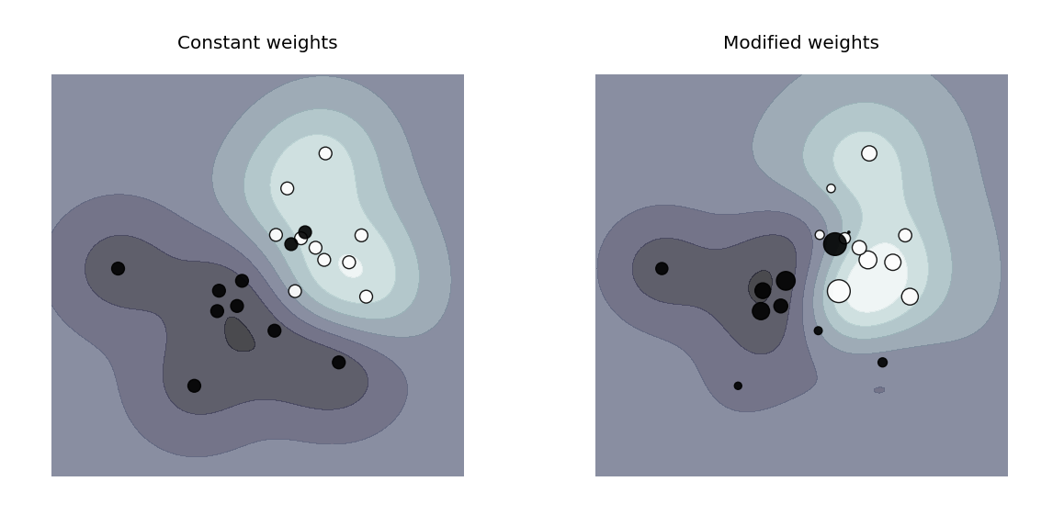
Support Vector Machine

Slide 18
Support Vector Machine
Effective for high-dimensional spaces
Still work when N(feature) > N(sample)
Memory efficiency
Adaptable Kernel functions
Poor when N(feature) >> N(sample)
No probability provided

Slide 19
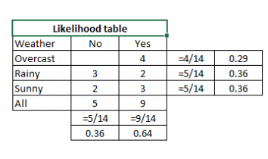

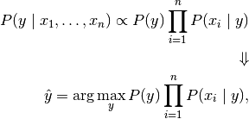
Naïve Bayes
Independence
assumption
Bayes
P(Yes|Sunny) = P(Sunny|Yes)*P(Yes)/P(Sunny)
Already Know:
P(Sunny|Yes) = 3/9 = 0.33
P(Sunny) = 5/14 = 0.36
P(Yes)= 9/14 = 0.64
Then:
P(Yes|Sunny) = 0.33*0.64/ 0.36 = 0.60
Classification

Slide 20
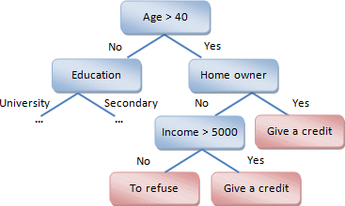




Decision Trees
Node (m)
Branch
Class (k)
Classification criteria
Gini
Entropy
$$[0, 1−\frac{1}{N}]$$
Choose the feature/class-condition
with highest Gini/Entropy
$$[0, logN]$$

Slide 21
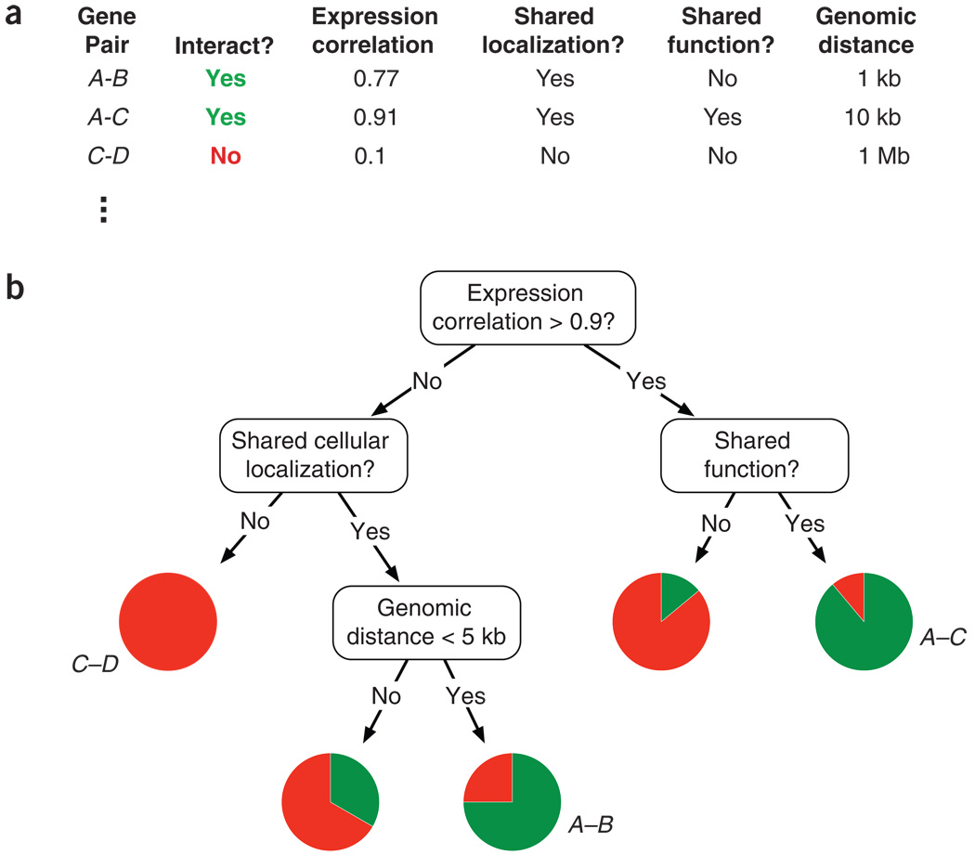
Decision Trees: Application

Slide 22
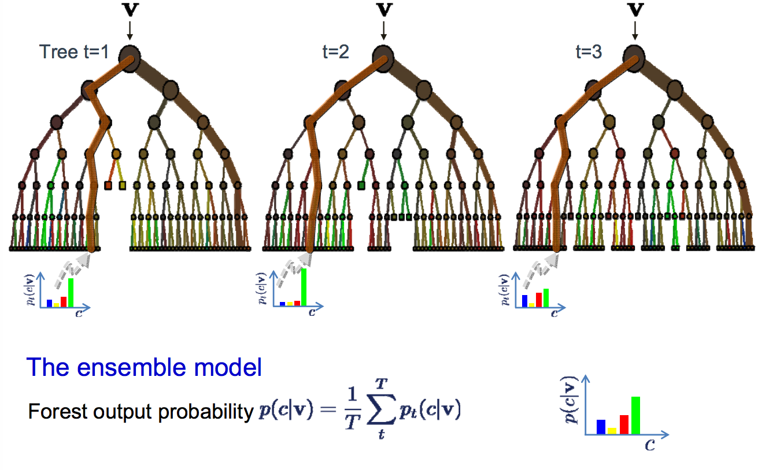
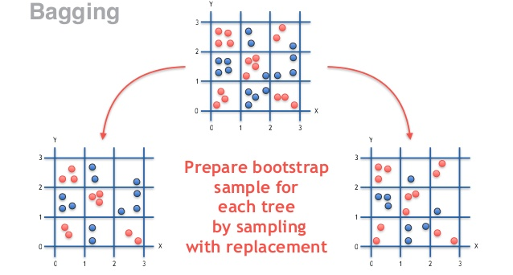
Random forest

Slide 23
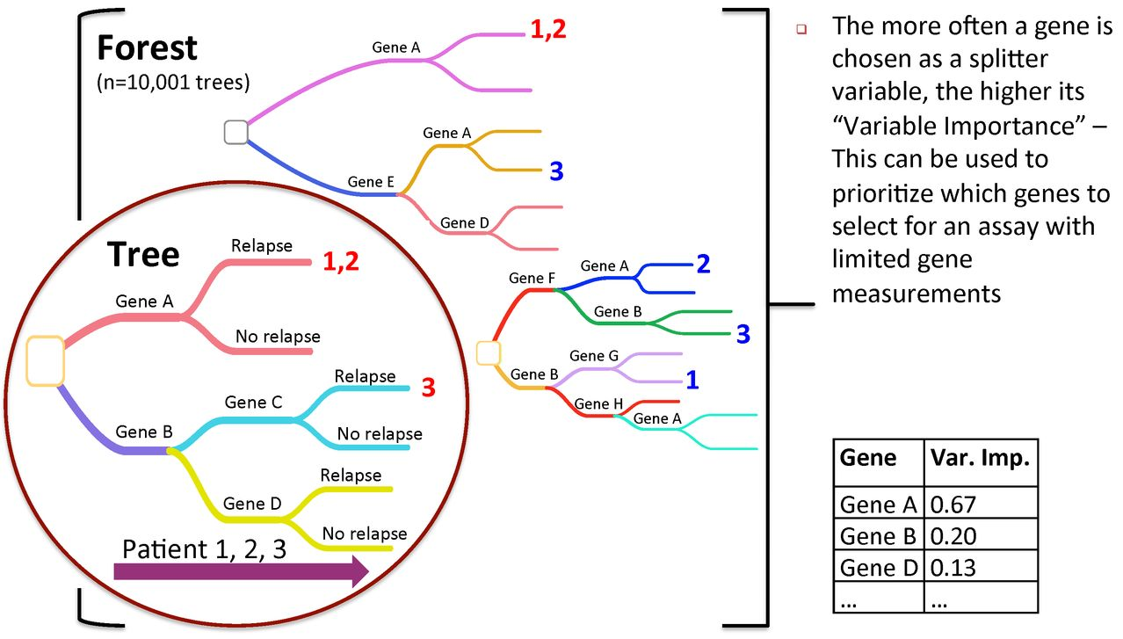
Random forest: Application
Less overfitting
Noise resistance
Good for high-dimension
Parallel
Feature correlation
Large number of feature
Massive samples
Overwhelm correct result

Slide 24
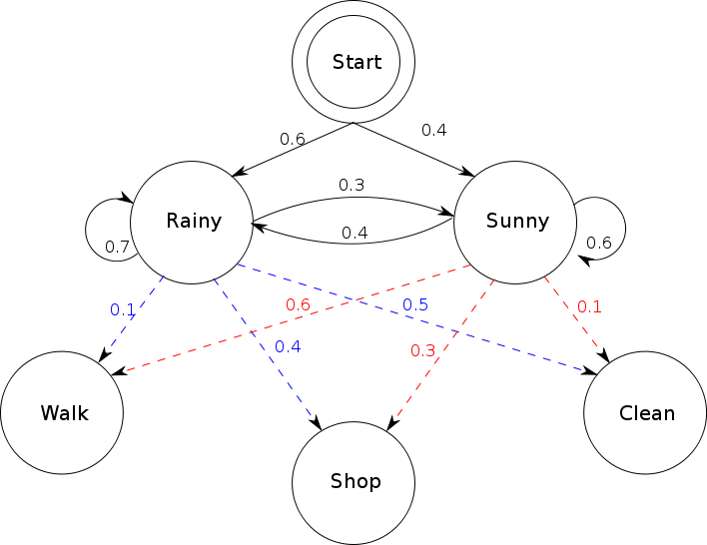
Hidden Markov Model
Q | Prior | Predict | Algorithm
1 | All probability matrices; An observation sequence | Probability of this sequence | Forward; Backward
2 | All probability matrices; An observation sequence | The states for the sequence | Viterbi Algo
3 | An observation sequence | All probability matrices | Baum-Welch
Initial
probability
states
Transition
probability
Emission
probability
observations

Slide 25
Hidden Markov Model: application
Multiple sequences alignment (ab initio)
  Combine and recognize related sequences
Gene finding
  Mapping gene from spliced RNA
Gene expression clustering
  Hidden Markov Model based clustering, scored by joint likelihood
Copy number variation detection
  SNP genotype array

Slide 26
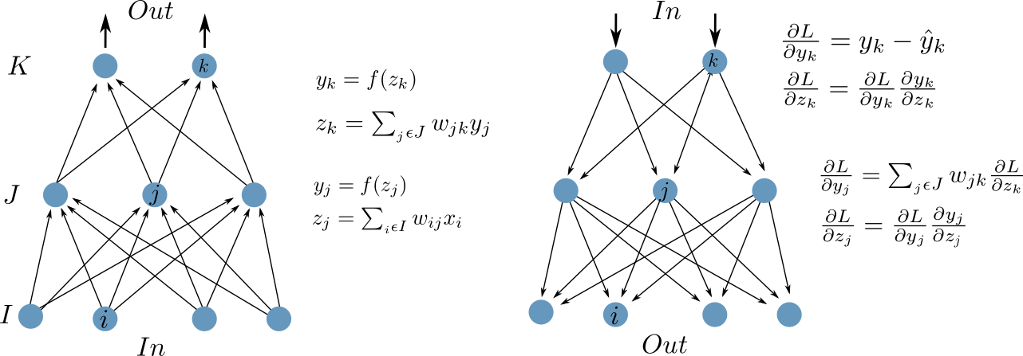


Neural Network: perceptron
Forward
$$W_{ij}^{′}=W_{ij}+x_{i}\frac{∂E}{∂z_{j}}$$
Backward
$$W_{jk}^{′}=W_{jk}+y_{j}\frac{∂E}{∂z_{k}}$$

Slide 27
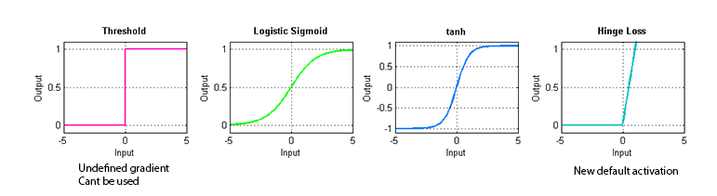
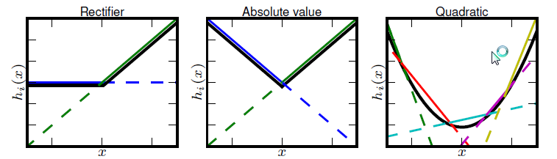




Neural Network: activation function
$$f\left(x\right)=\frac{1}{1+e^{−x}}$$
$$f\left(x\right)=tanh⁡(x)$$
$$f\left(x\right)=ℋ(x=0)$$
$$f\left(x\right)=max⁡(0, x)$$
MAXOUT
$$f\left(x\right)=max⁡\left\{z_{k}=x∙w_{k}+b_{k};k=1\sim n\right\}$$

Slide 28
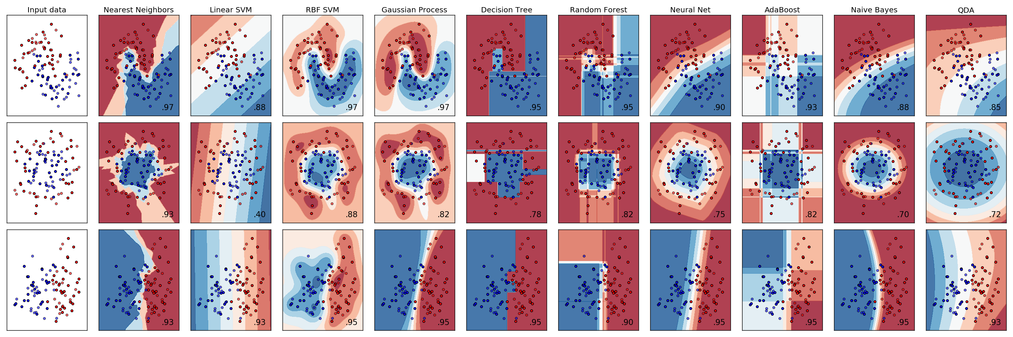
comparison
Input
data
Nearest
Neighbors
Linear
SVM
RBF
SVM
Gaussian
Process
Decision
Tree
Random
Forest
Neural
Network
Ada
Boost
Naïve
Bayes
QDA

Slide 29
Unsupervised learning
Dimensionality reduction: PCA, ICA, tSNE
K-means clustering
Gaussian Mixture Models
Hierarchical Clustering
K Nearest Neighbors Clustering

Slide 30
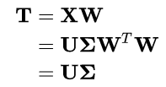


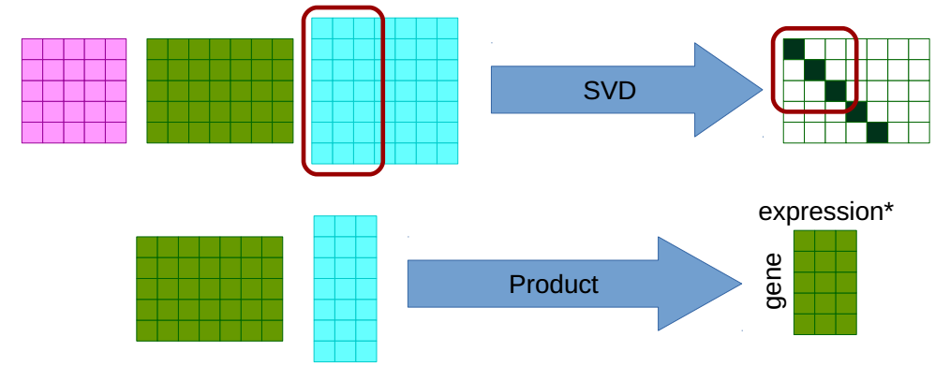
PCA: Singular value decomposition
W
X
U’
∑
U’L
TL

Slide 31
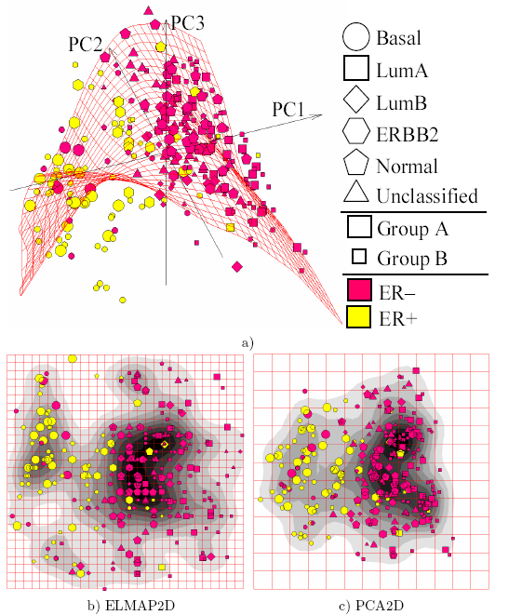
PCA
Fast
Real distance between samples
Most important components
Orthogonal
Almost lossless
Stable
Obscure division
Components may not specific

Slide 32
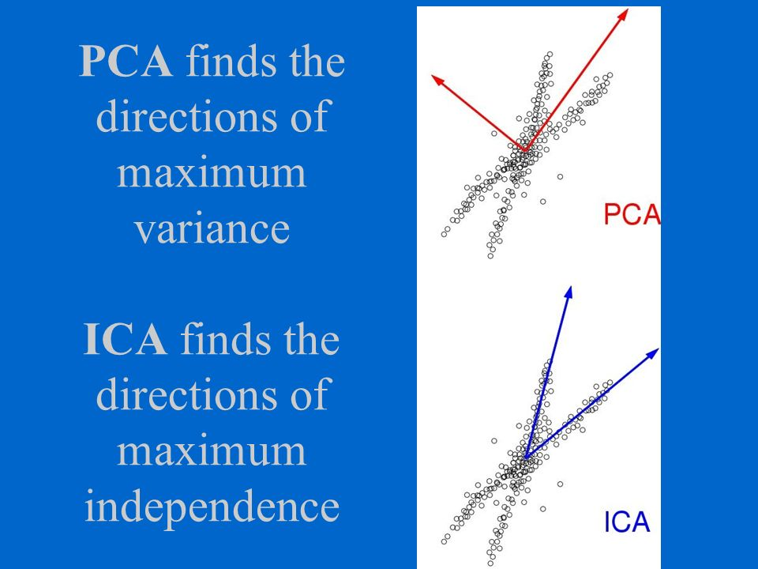


ICA (Independent component analysis)
Maximum likelihood estimation
Most specific components
Non-orthogonal
Unstable

Slide 33
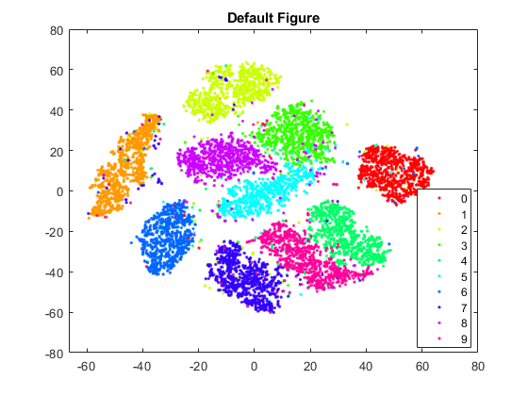




tSNE (t-distributed stochastic neighbor embedding)
Evident division
Adjustable parameters
Not the real distance
Hard to heritage

Slide 34



K-means

Slide 35




K-means
Fast
Good for vivid density contrast
Define K first (cluster number)
Estimate block center first
Poor Robustness

Slide 36





Gaussian mixture model
Probability Density
Likelihood function

Slide 37


Hierarchical clustering

Slide 38





Hierarchical clustering
Single
Average
Complete
Ward

Slide 39


Slide 40


Hierarchical clustering
No
Connectivity?
Yes

Slide 41





K nearest Neighbors
1NN
5NN
Condensed NN
1NN

Slide 42


K nearest Neighbors
Connectivity
matters!!

Slide 43


DBSCAN (Density-based spatial clustering of applications with noise)

Slide 44


