Slide 1
Single-cell RNA sequencing technologies
Why single-cell analysis is needed?
Main challenges in single-cell technologies?
Introduce Fluidigm, 10X, and Multiplex single cell methods.
Discussion:
Differences of analytical approaches used for single cell data.

Slide 2
Why single cell analysis is needed?
tumor heterogeneity

Slide 3
4-6 Trillion Cells

Slide 4
Human Cell Atlas
To create comprehensive reference maps of all human cells-the fundamental units of life-as a basis for both understanding human health and diagnosing, monitoring, and treating disease.
The immune system
The brain and nervous system
Epithelial tissue
Cancer

Slide 5
Main challenges in single-cell technologies
Experimental:
Single-cell isolation (avoid duplex) and identification
Low copy number
Library complexity
High-throughput cost
Analytical:
Quality control and data normalization
Every other aspects: SNP calling, transcript quantification, DNA accessibility…
Realize:
Microfluidigm based technology
Droplet-based platform
Multiplex methods based on FACS

Slide 6
Most have been single celled

Slide 7
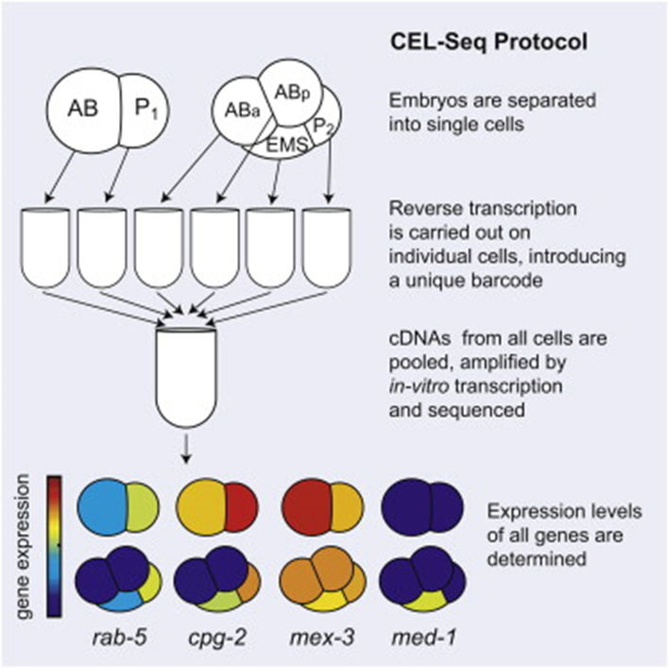
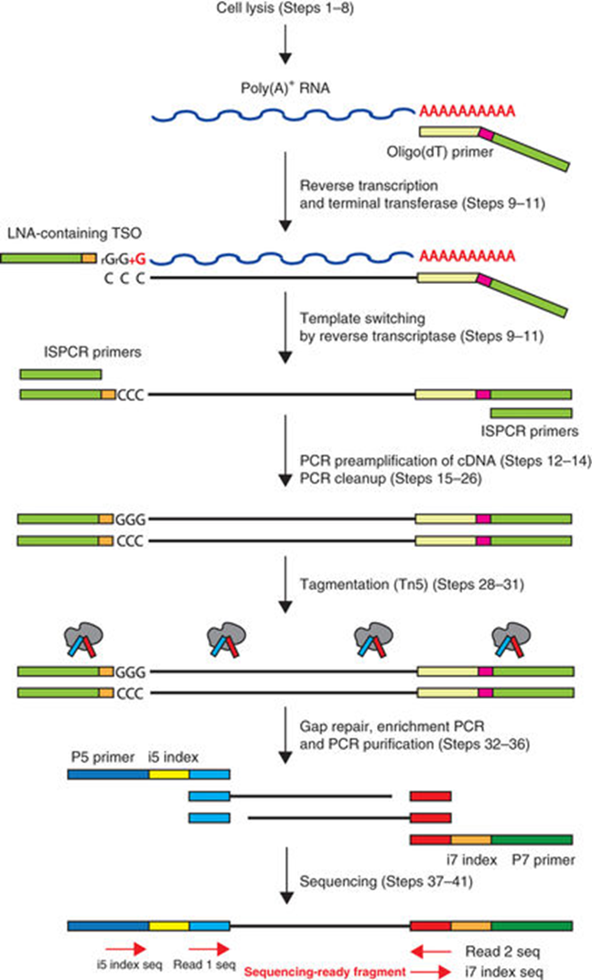
Initial scRNAseq methods
Cel-seq
Smart-seq

Slide 8
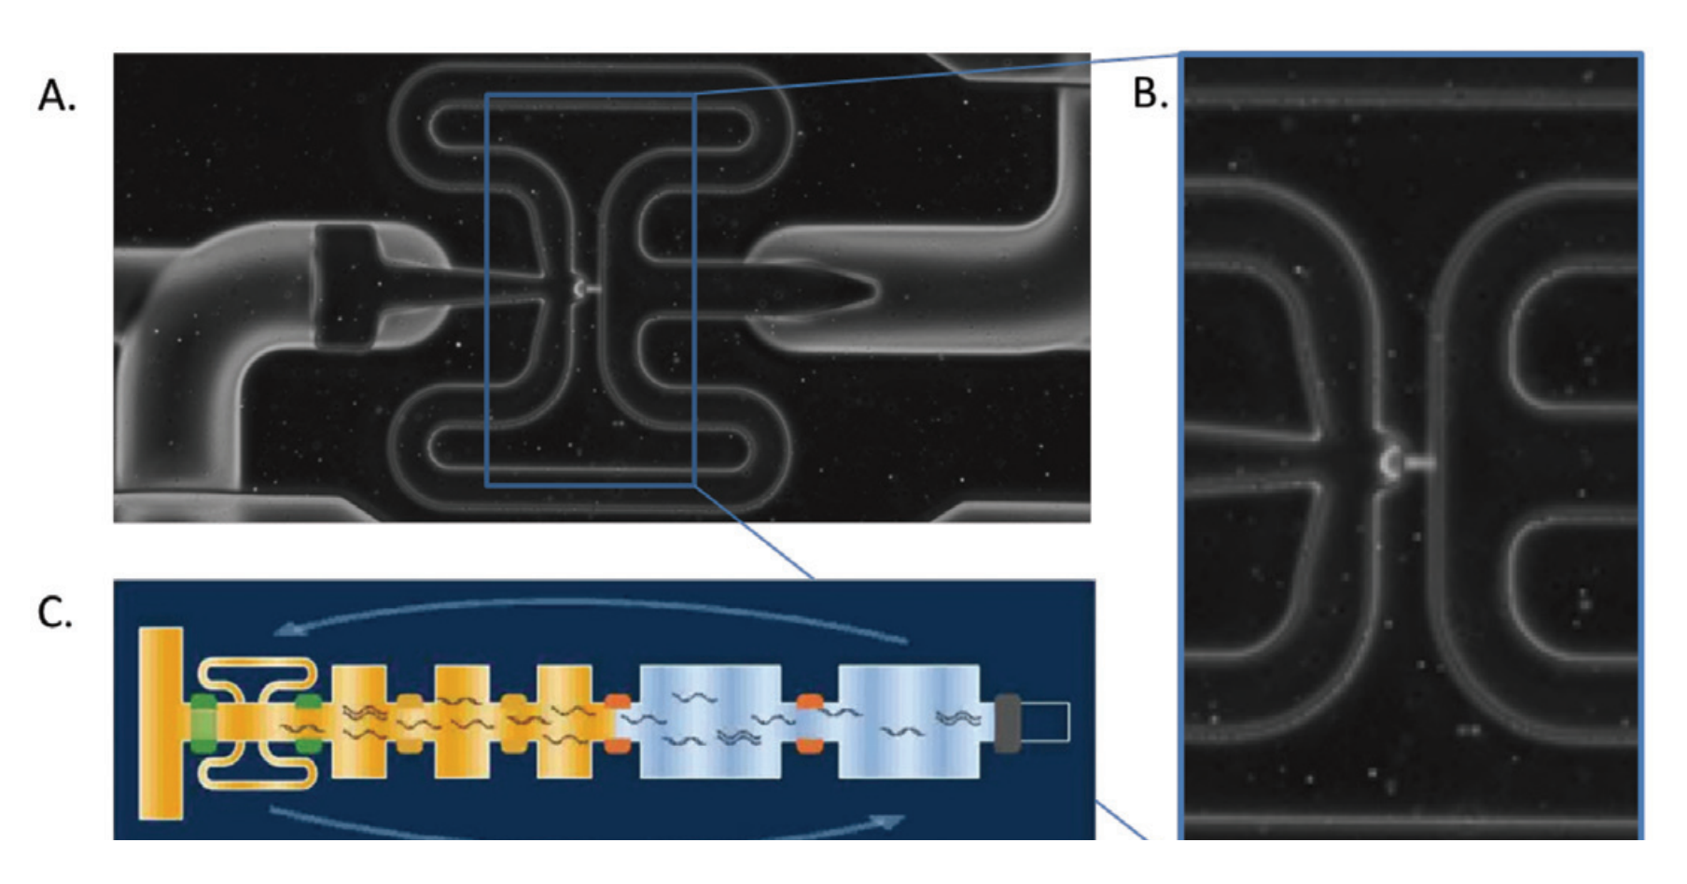
Fluidigm C1 integrated fluidic circuit capture site and multi-step reaction architecture

Slide 9
Droplet-based platform enables barcoding of cells

Slide 10
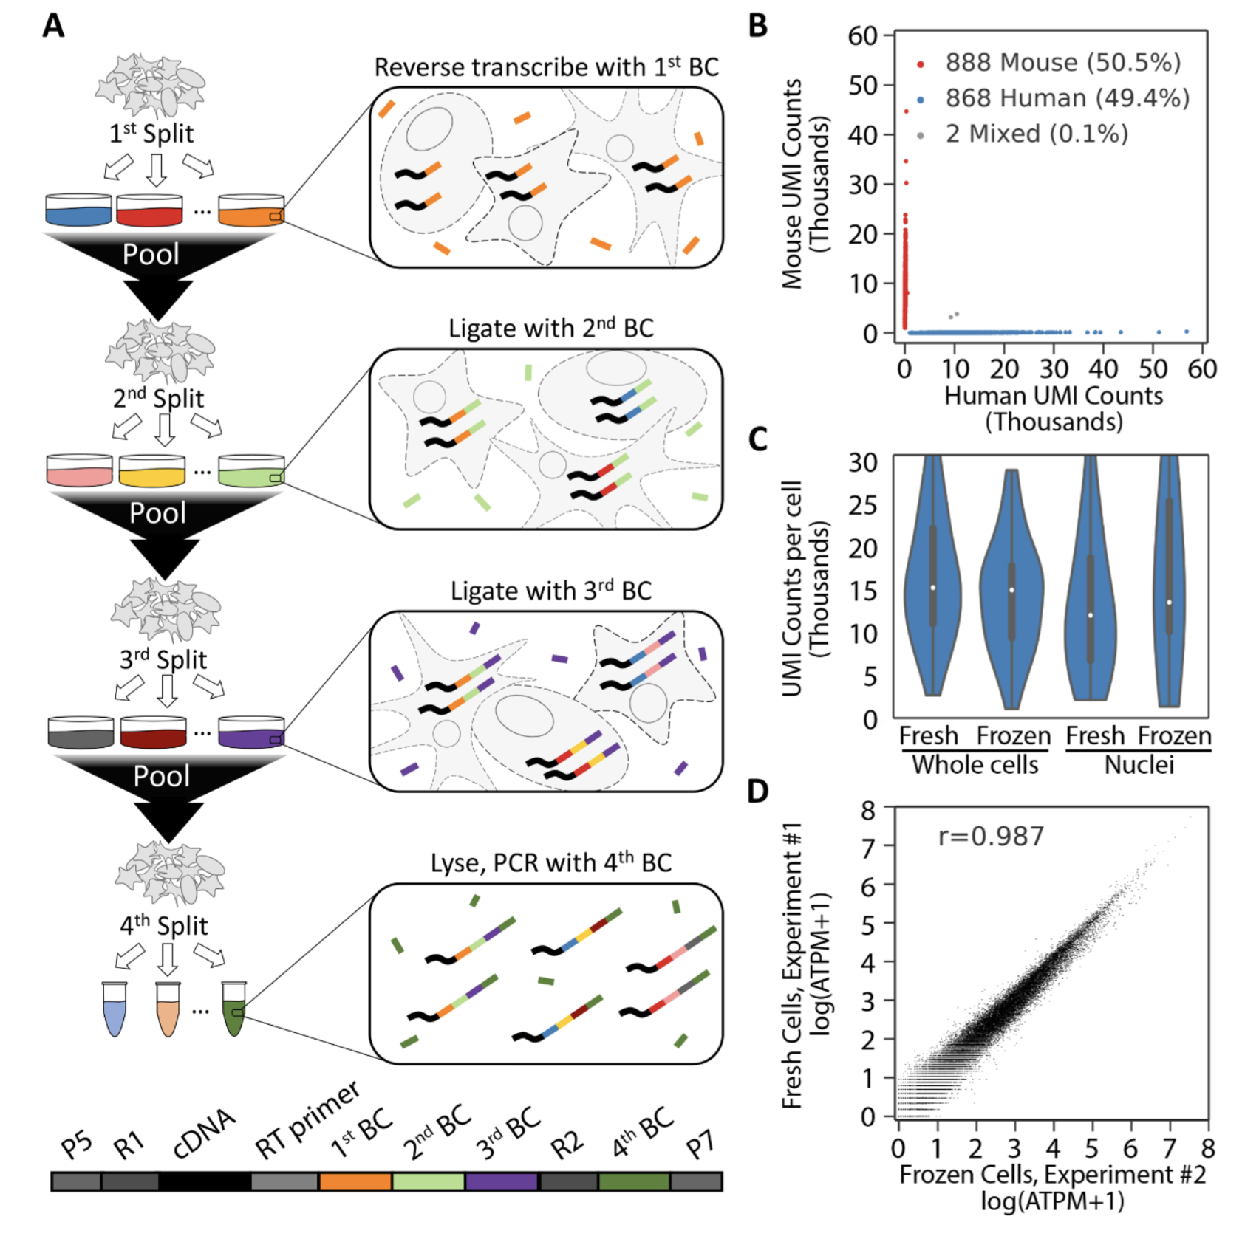
Multiplex method based on FACS
Rosenberg et. al, Science, 2018

Slide 11
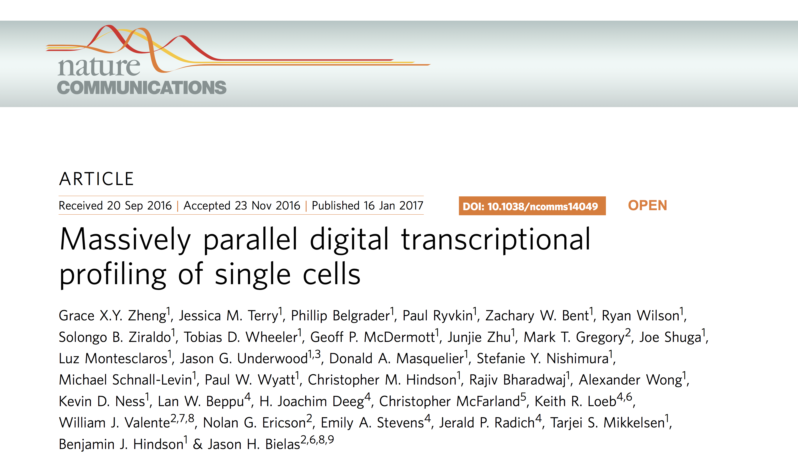
Example 1, 10X Genomics
Droplet-based platform

Slide 12
Drop-based system
Is it reliable?
Sensitivity: Cell line & synthetic RNA
Massive population: PBMC
How can it be applied?
Sequence variation; AML patients
What’s it like?
What’s it advantage?

Slide 13
Technical demonstration with cell lines and synthetic RNAs
Multiplet rate: relatively low: 1.6%
Capture rate: the ratio of the number of cells detected by sequencing and the number of cells loaded: 50%
Detected ~4,500 genes and ~27,000 transcripts, in the depth of 100k read per cell.

Slide 14
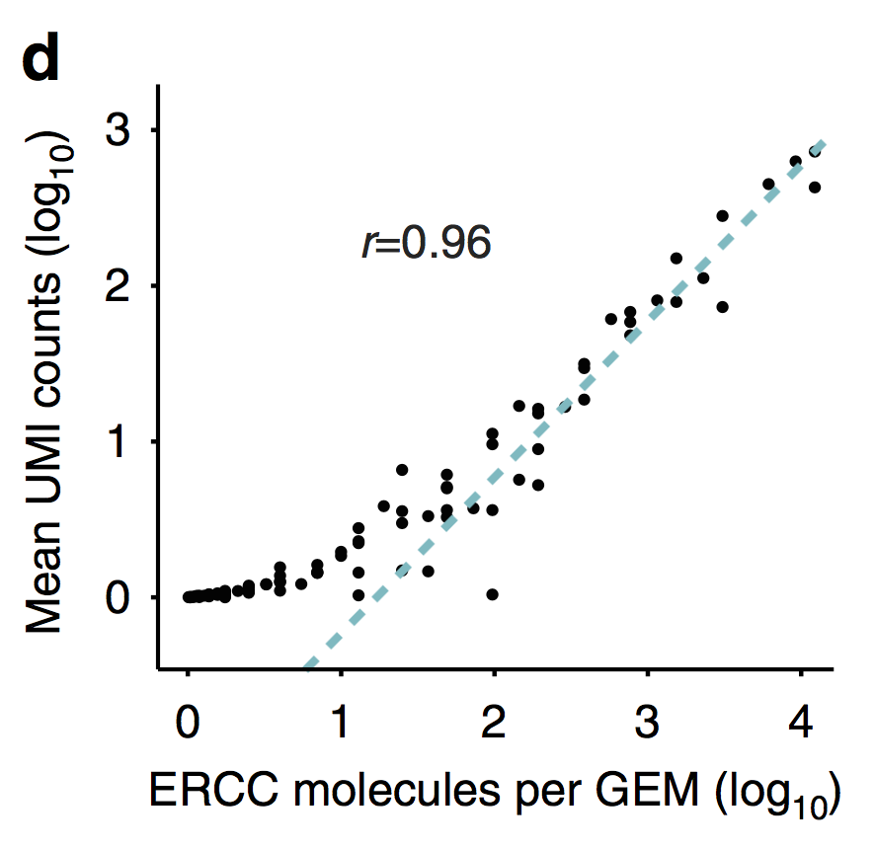
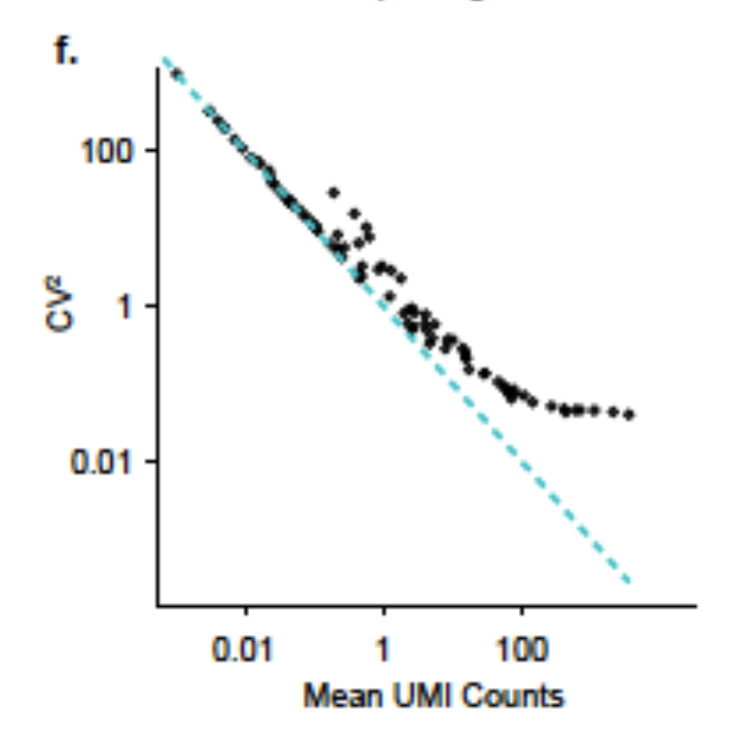
Mean UMI counts from sequencing highly correlated with molecule counts calculated from the loading concentration of ERCC.
When UMI counts are small, sampling noise dominates; when the UMI counts increase, technical variations become dominant.

Slide 15
Detection of individual populations in mixed samples
SNV: single nucleotide variation

Slide 16
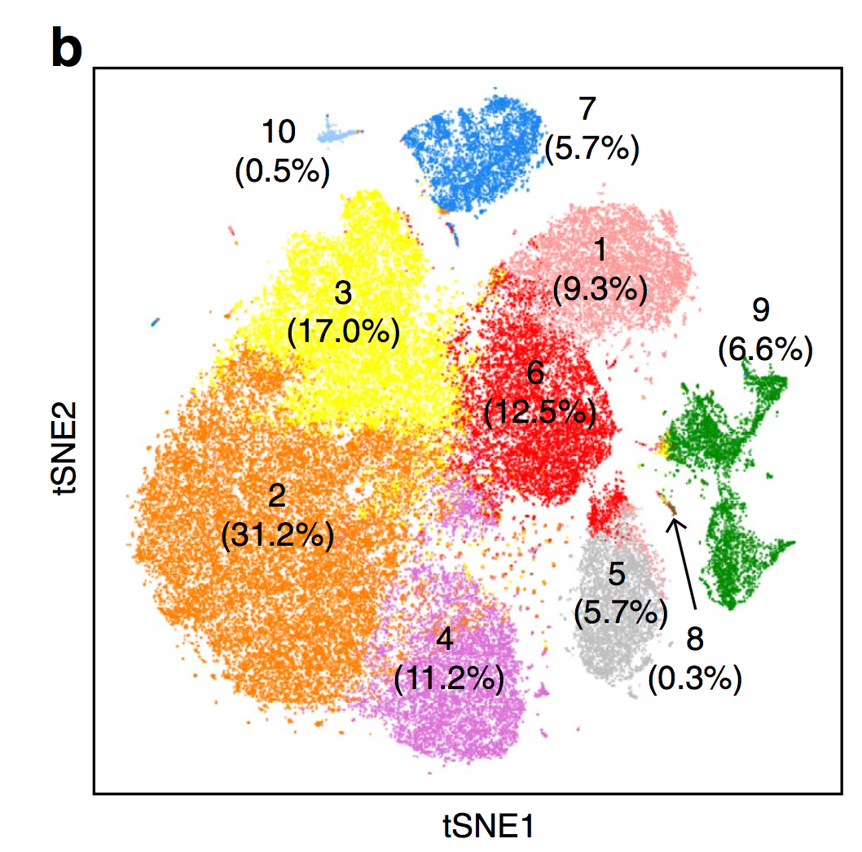
Subpopulation discovery from a large immune population

Slide 17
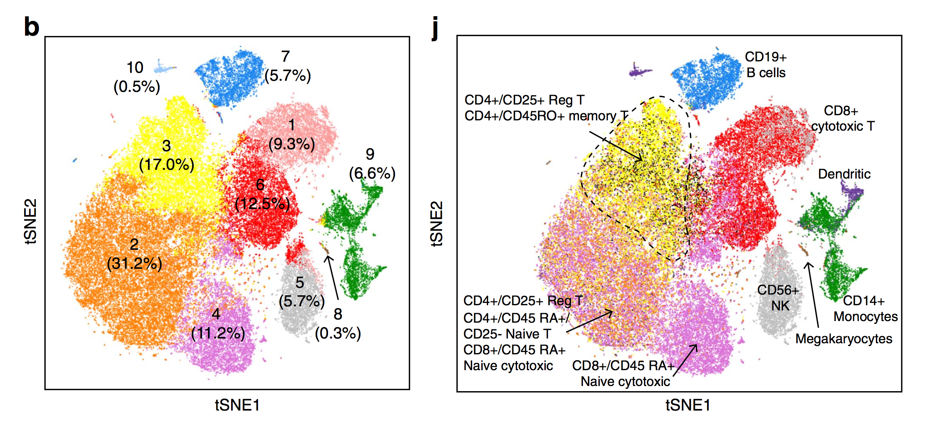

Slide 19
Name: Date:
1. Why single cell analysis is needed ?
2. List three main challenges on single cell sequencing experiments.
3. List three single cell library preparation methods.
4. What are the main differences between bulk and single cell RNA-seq analysis?

