Slide 1
RNA secondary structure
(PRAS, icSHAPE)
How to identify transcriptome-wide RNA secondary structure?
Why do we care?
Discussion:
  Limitations of current RNA structure probing methods?
  How could computational methods improved?

Slide 2
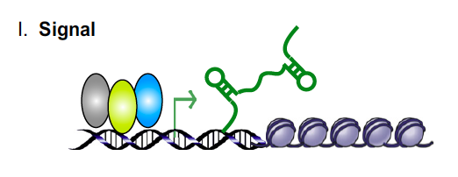
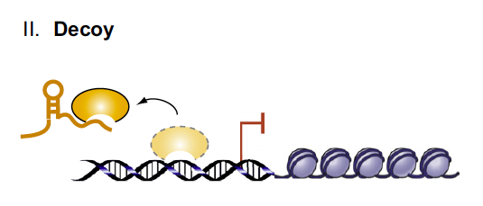
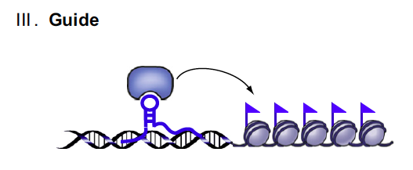
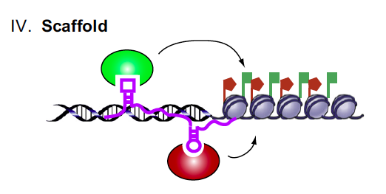
The Central Dogma
DNA
transcription
RNA
translation
Protein
Single stranded
Flexible/unstable
Localization
The SHAPE
Notes:
I was not trained as a biologist, and the central dogma was almost the only thing I knew in modern biology.
RNA characteristics makes RNA study more challenging and thus more interesting.
Instead of a liner structure, they all seems to work together for a particular function.
Get a figure for X-inactivation.
We noticed that other than the sequencing of the RNAs, one of a key factor that affects RNA in functioning in all these processes is its SHAPE

Slide 3
Can we profiling RNA secondary structures genome-widely?
Dr. Johnson Weissman @ UCSF
Dr. Howard Chang @ Stanford

Slide 4
Parallel Analysis of RNA Structure (PARS)
mRNA
CAP
AAAAAA
In vitro or in vivo
folding
S1
V1
RNAse V1 digestion
RNAse S1 digestion
5’P
5’P
random fragmentation
random fragmentation
5’P
5’OH
5’P
5’OH
library preparation
library preparation
deep sequencing
deep sequencing
V1 profile
S1 profile
# reads
AGGCAUGCACCUGGUAGCUAGUCUUUAAACCAAU
AGGCAUGCACCUGGUAGCUAGUCUUUAAACCAAU
PARS Score
0
AGGCAUGCACCUGGUAGCUAGUCUUUAAACCAAU
Kertesz, Wan et al., Nature, 2010.
Notes:
First iteration is RNA folding in vitro—structural information in RNA sequence itself. As a first proof of principle, we did this on mRNAs from yeast, and this is what I will show you. More recently, we have developed methods to isolate natively folded RNA from cells without denaturing, which allows us to probe RNA structure in different biological states.
-We and others, including work by Dr. Doudna, developed methods to increase throughput.
We believe this technology reveals a New layer of transcriptome organization

Slide 5
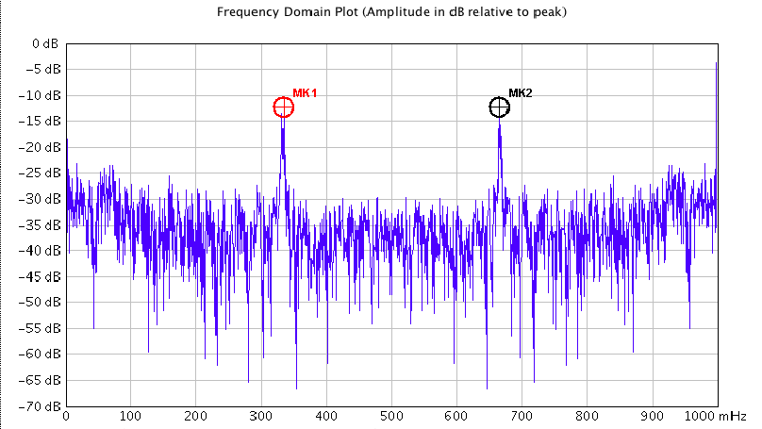
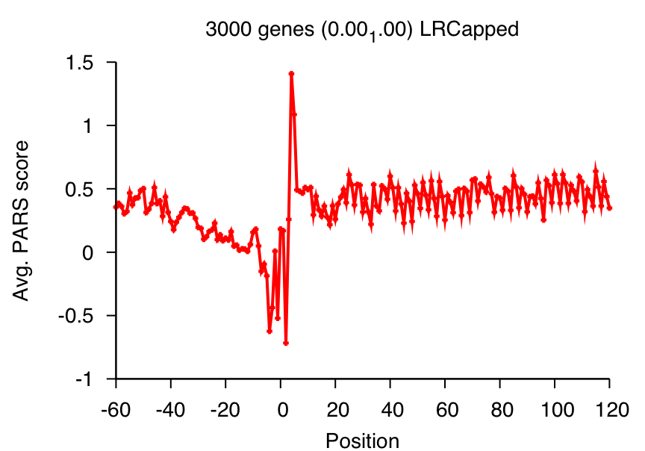
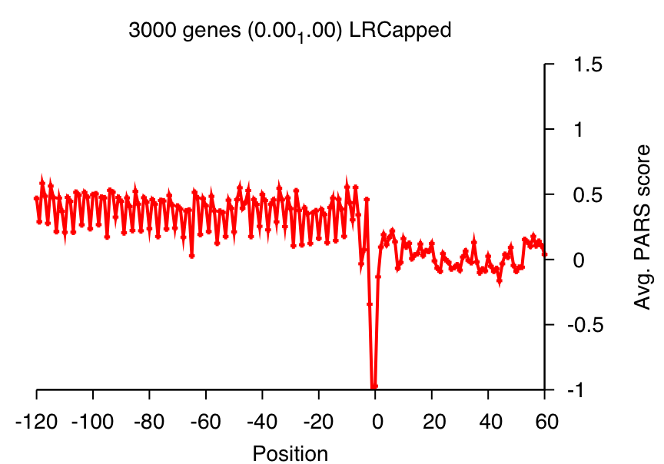
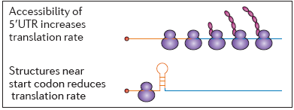
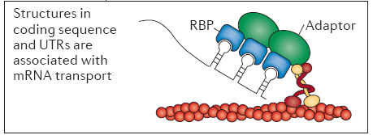
2○ Structure landscape of mRNAs
Start
Stop
Paired
0.37
0.17
-0.008
5’ UTR
CDS
CDS
3’ UTR
Unpaired
Wan Y. et al, Nat. Rev. Genetics, 2011
Notes:
Some features predicted by previous computational predictions. This is first systematic proof.
Wiggly signal in CDS.
Better explain RBP data, same applies to miRNA targets

Slide 6
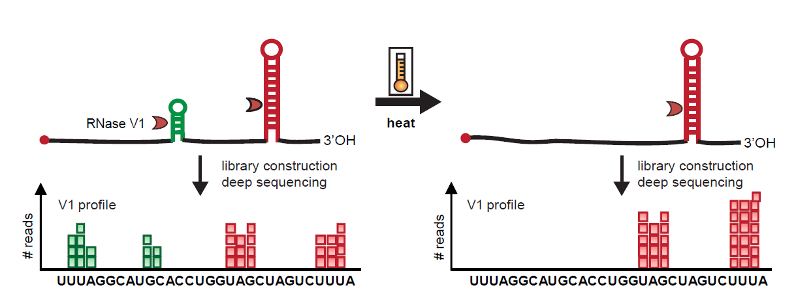
Parallel Analysis of RNA by Temperature Elevation (PARTE)
By graded temperature elevation, reveal possible pairing nucleotides
Genome-wide RNA calorimetry-- direct measurement of free energy of RNA folding
Wan et al., Mol. Cell, 2012
Notes:
All of you who have worked with primers know how hybridization is a function of temperature. Specifically, a classical method called RNA calorimetry tracks how different bases in structured RNAs unfold at different temperatures. In cartoon example, calorimetry will show RNA contains two structured helices, one melts at 37, and the other one melts at higher temperapture.
If we visualize this on PARS, we see four peaks. I have color coded the nucleotides to show how they pair up. But we do not know this ahead of time. Also you notice that the even though the number of ds pairs may not correspond directly to the number of nucleotides of V1 reads b/c data is noisy. But if we melt (i) energetic environment of the green bases. (ii) reveal green-green and red-red.
If we deep sequence a fixed number of reads, as we lose reads on green bases, we gain reads on red bases.

Slide 7
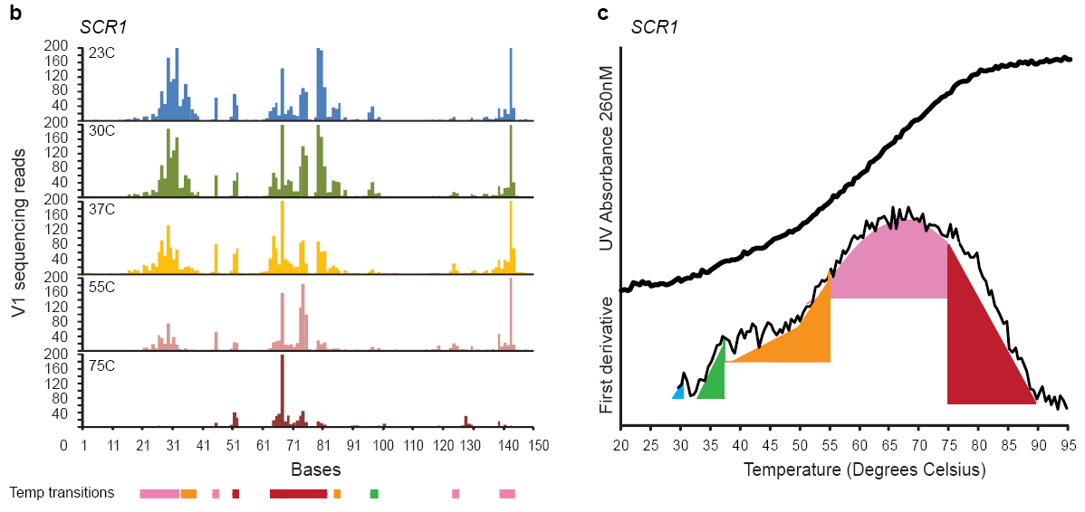
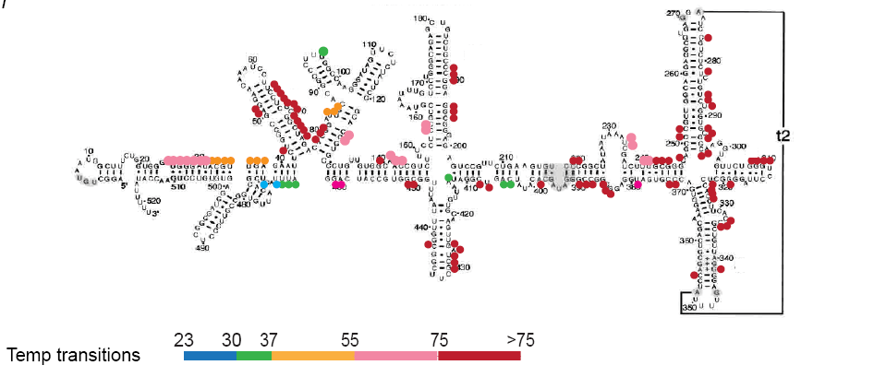
Parallel Analysis of RNA by Temperature Elevation (PARTE)
SCR1
Wan et al., Mol. Cell, 2012
Notes:
party evaluation
Careful controls to show enzymes maintain spec at diff temperatures. Enzyme concentration corrected for diff kinetics using doped in controls. We know that for RNA that does not melt we get exactly same Rnase footprint pattern.

Slide 8
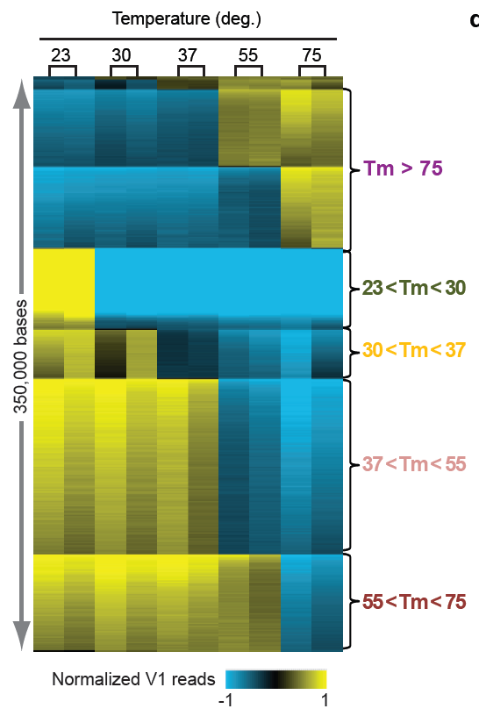
Energetic landscape of RNA folding
genome-wide
Normalized V1 reads
Wan et al., Mol. Cell, 2012
Notes:
Party can detect melting temperatures per base.
Top 5% of bases from 4842 genes (total number of bases for 4824 genes ~70million, so 5% of 70million = 3.5million bases.
Samples: 2 replicates of each temperature.
This is done after 11nt smoothing. Added additional 2 rows of 23C and 75C to enable more efficient calling of the early and the late transitions
Transitions called with Stepminer (FDR 0.15)
Mean centered per base, red means higher than median; green means lower than median.
Highly reproducible. Single transition.
Melt 30-37 is a minority.

Slide 9
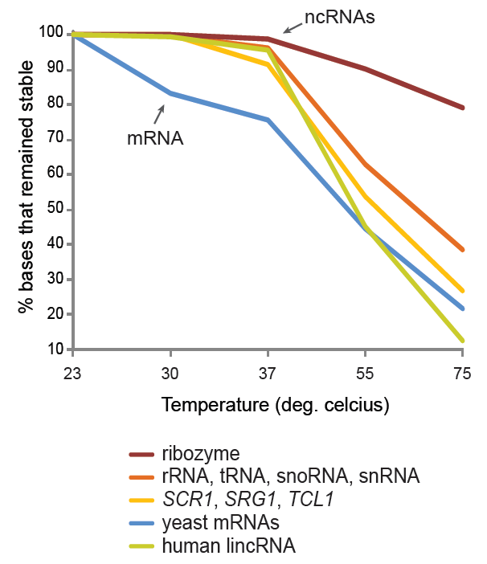
Melting profiles distinguish RNA classes
Wan et al., Mol. Cell, 2012
Notes:
Structural RNAs from coding RNAs. Nice validation: exactly known from classical biophysics work. High structural stability is hard to evolve.
lincRNAs look like other structural RNAs. Can potentially distinguish many antisense and ncRNA transcripts in human, between structural RNAs vs. noise. Not based on sequence, but biophysical properties
Transition: can also look at not just entire transcript, but energetic landscape of specific portions of transcript.

Slide 10
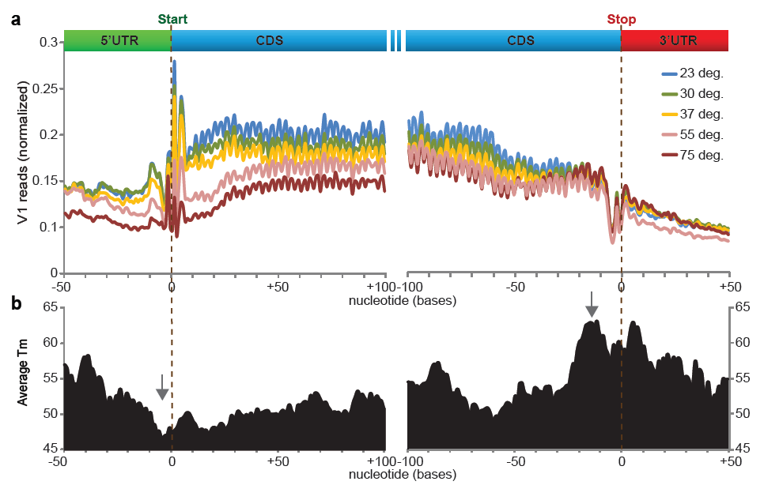
Energy landscape demarcates ORFs
Wan et al., Mol. Cell, 2012
Notes:
This landscape of melting temperatures in mRNAs demarcates open reading frames
Previously on static picture, translation start and stop both look like local minima—about the same. Confirms the globe pattern of RNA structure across functional portions of mRNAs, and confirmed predictions that UTRs are more accessible. Here we show…using rainbow colors. 5
5’ UTR before start codon is energetic minima of transcript—structurally organized to direct translation initiation—start tape here. Per base average Tm can be calculated, and The most meltable part of the entire mRNA reside in this area. And the most stable regions are here. Response to temperature also raise hypothesis about translational regulation.
Correlation of Tm vs GC content is also studied, and we believe the polarity of structure stability is hence likely to be consequences of secondary or higher order structures of RNAs that can be directly detected by this technology.

Slide 11
Can we extend PRAS to mammalian systems?
Notes:
Which has a way more complex transcriptome

Slide 12
RNA structure probing of the human transcriptome
Nuclease | Cell type | Individual | Mapped Reads
V1 | Lymphoblastoid cells | GM12891 | 103 million
S1 | Lymphoblastoid cells | GM12891 | 108 million
V1 | Lymphoblastoid cells | GM12892 | 104 million
S1 | Lymphoblastoid cells | GM12892 | 120 million
V1 | Lymphoblastoid cells | GM12878 | 110 million
S1 | Lymphoblastoid cells | GM12878 | 120 million
Global properties of the human RNA structurome
miRNA
accessibility
Impact of human variations (SNPs) on RNA structure
92
91
78

Slide 13
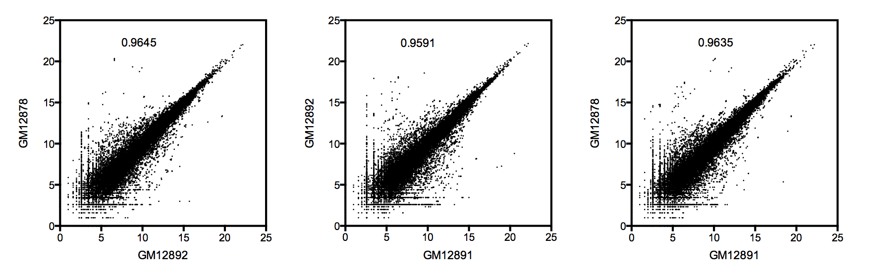
Human PARS data has high correlations across biological replicates
Wan & Qu et al Nature 2014

Slide 14
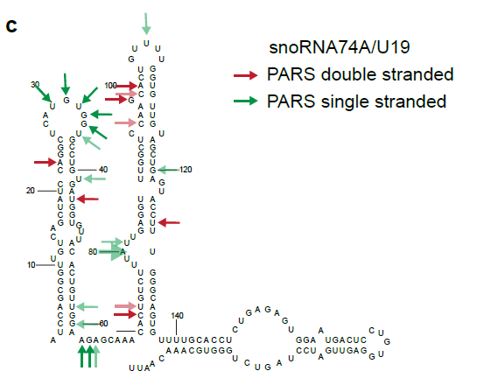
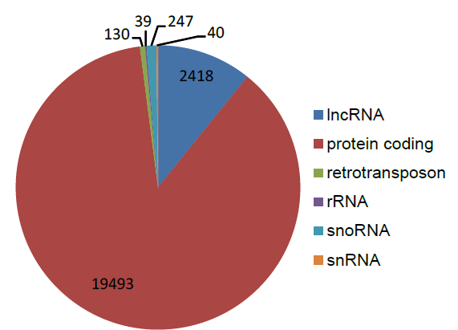
Human PARS provides structural information for thousands of genes in the human transcriptome
Wan & Qu et al Nature 2014

Slide 15
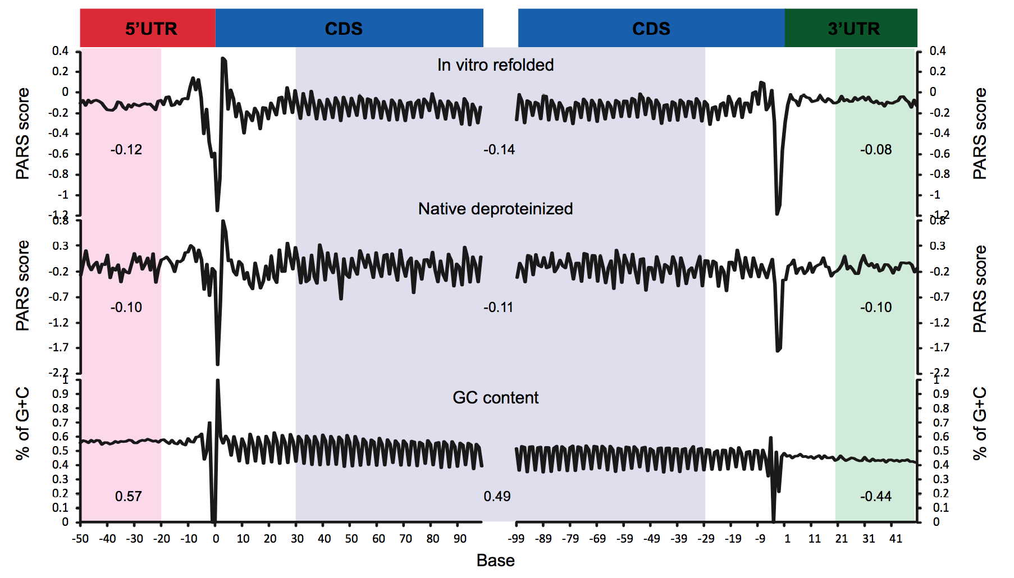
Secondary structure landscape of human mRNAs
Wan & Qu et al Nature 2014

Slide 16
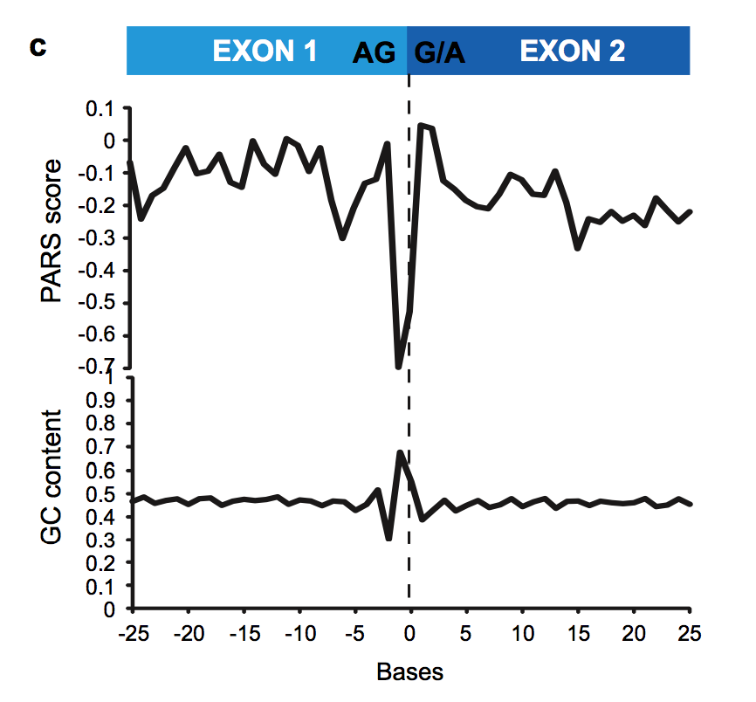
Secondary structure profile across exon-exon junctions
Wan & Qu et al Nature 2014

Slide 17
Can we use PRAS profiling to
discover/validate some biology?

Slide 18
Mammalian microRNAs are important in development and tumorigenesis
Short: ~22-nt
Expressed: 1000s identified, tissue- and cell-type specific
Functional: post-transcriptionally down-regulate half of our genes
Grace Zheng

Slide 19

RNA structure can be one rule in discriminating
good from bad microRNA targets
miRNA target prediction by
seed complementarity
AGO
miRNA
Predicted
miRNA target
AGO binding sites
Context of miRNA predicted sites matter:
Conservation
AU richness
Position along the 3’UTR
Coexpressed miRNAs
Target site accessibility
Publicly available AGO PAR-CLIP on EBV transformed lymphoblastoid cells
AGO iCLIP on GM12878, GM12891 and GM12892 cells
RNA structure?

Slide 20
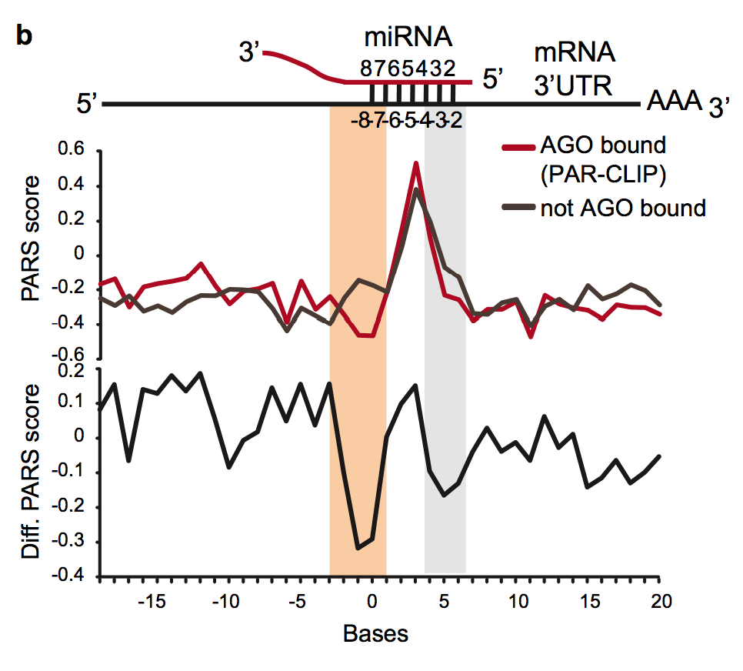
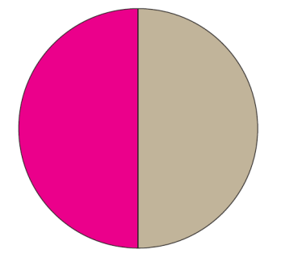
Predicted miRNA sites that are AGO bound are more accessible than non-AGO bound sites
AGO PAR-CLIP
Targetscan
predicted sites of top 100 miRNAs in GM12878 cells
AGO
Bound
Not
Bound
Wan & Qu et al Nature 2014

Slide 21
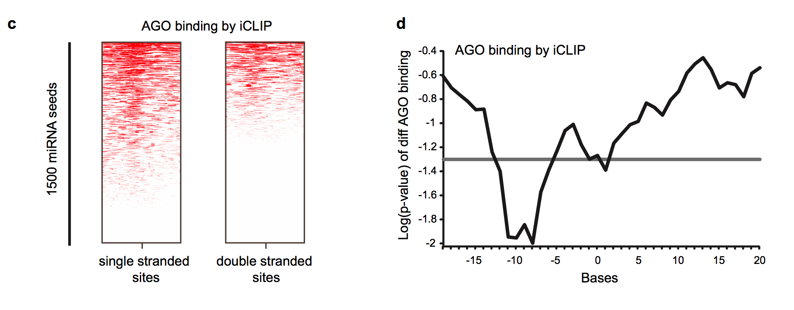
5’ accessibility of miRNA target sites is correlated with increased AGO binding
Wan & Qu et al Nature 2014

Slide 22
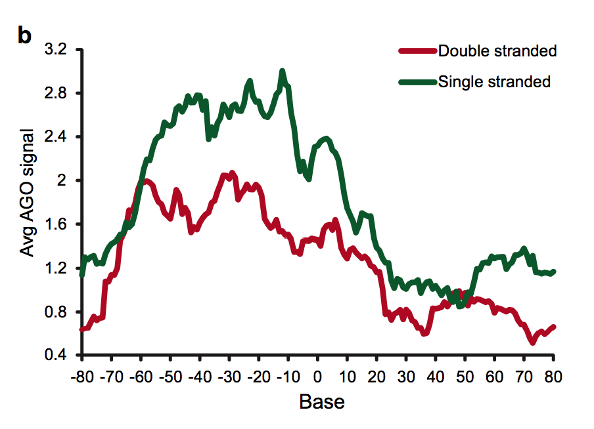
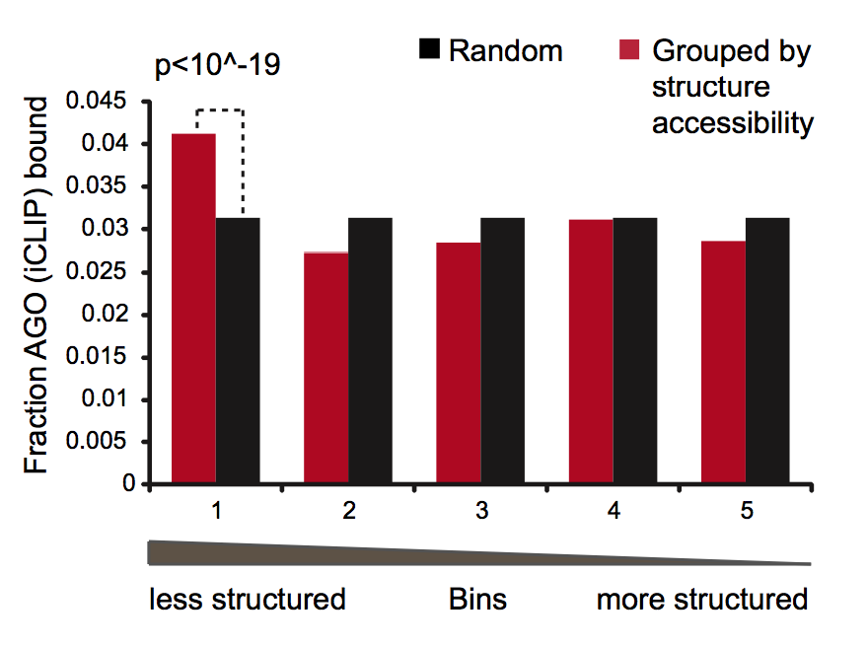
5’ accessibility of miRNA target sites is correlated with increased AGO binding
Wan & Qu et al Nature 2014

Slide 23
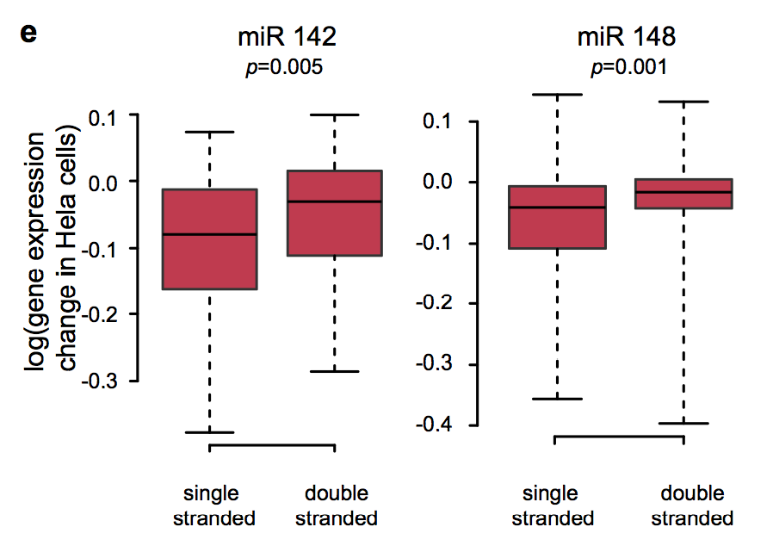
mRNAs with structurally accessible sites are more repressed in-vivo
Hela cells
Wan & Qu et al Nature 2014

Slide 24
Can PARS leads us to unknown biological discoveries

Slide 25
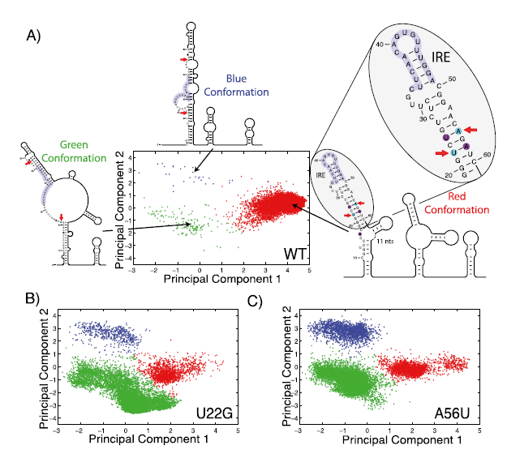
SNPs can change RNA structure predictions: RiboSNitches
Martin JS et al, RNA, 2012

Slide 26
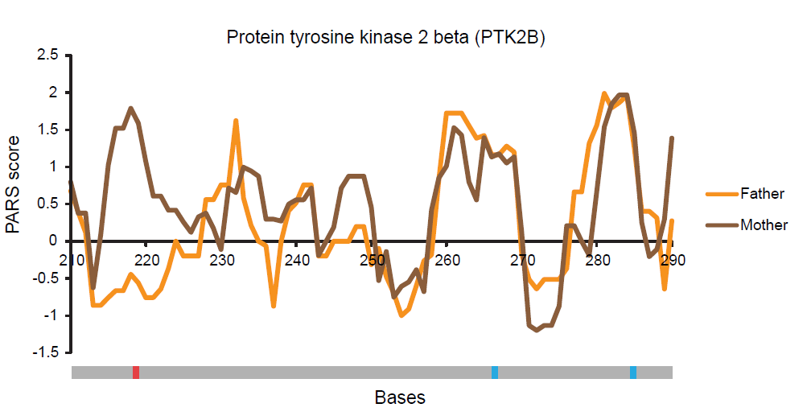

PARS can identify RiboSNitches in human transcriptomes
Wan & Qu et al Nature 2014

Slide 27
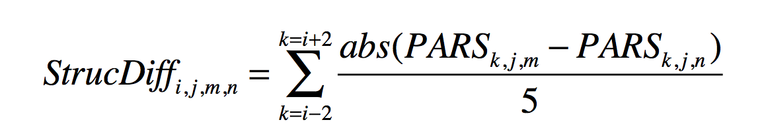
Stringent ways of defining RiboSNitch
1.
2. Select expressed SNVs by coverage
3. Define a Z-score which is StrucDiff/SD of doped in control
4. 1000 permutation – select out stable/significant structure changes
5. Adjust p-values to estimate FDR

Slide 28
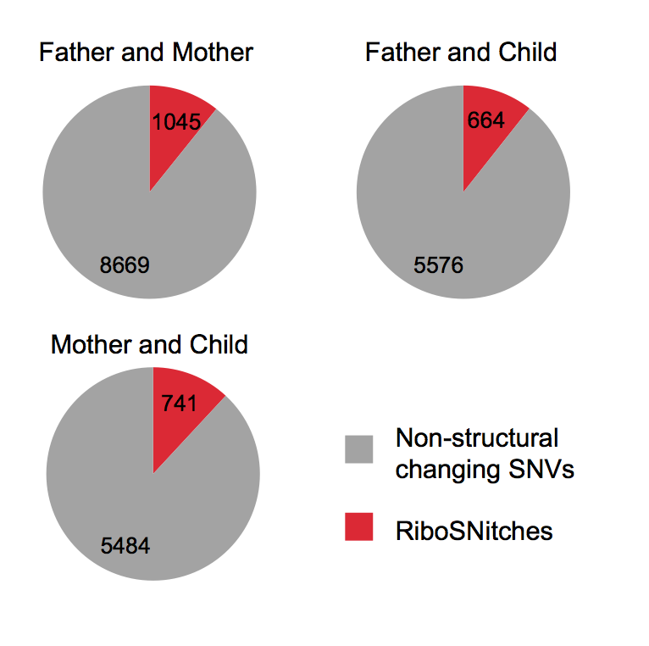
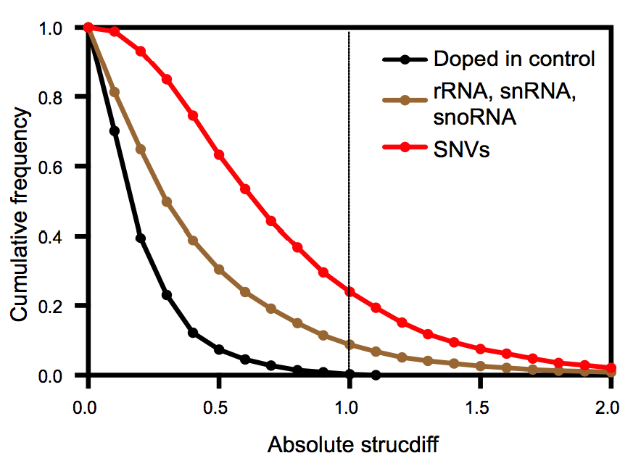
PARS identified >1900 RiboSNitches in the trio
Wan & Qu et al Nature 2014

Slide 29
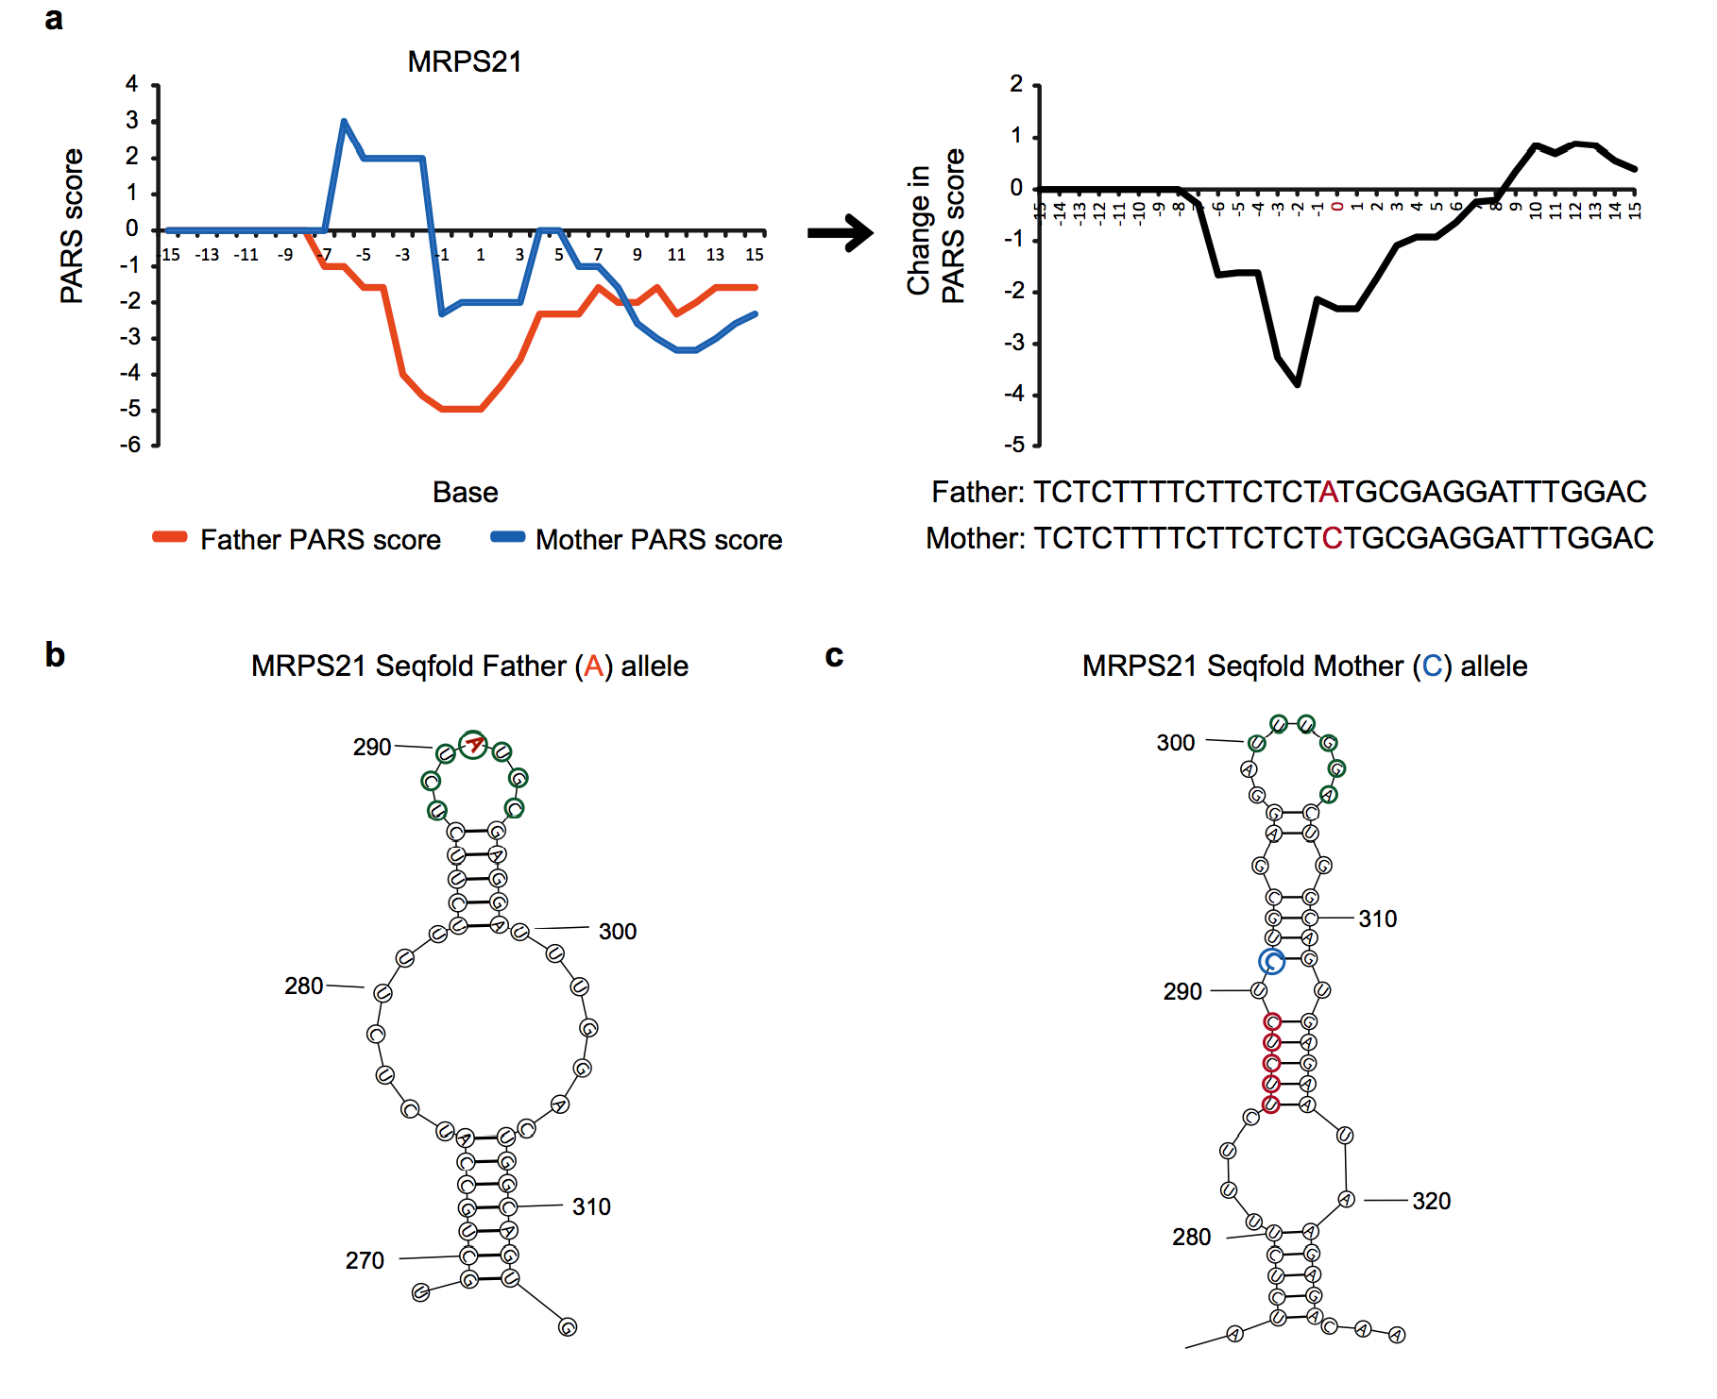
MRPS21 A291C is likely a RiboSNitch
Wan & Qu et al Nature 2014

Slide 30
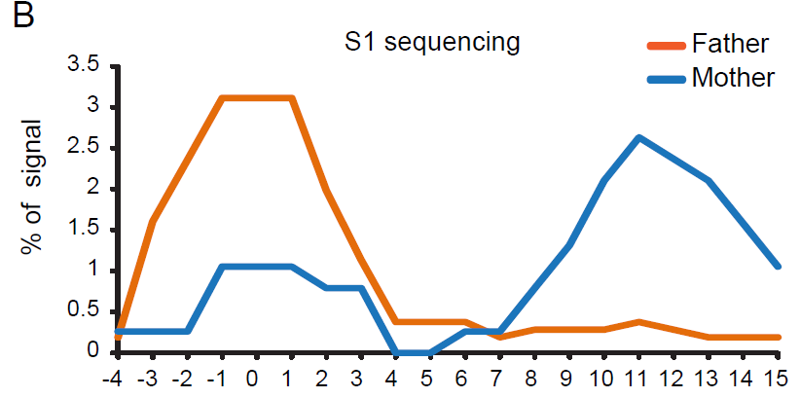
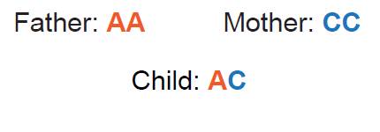
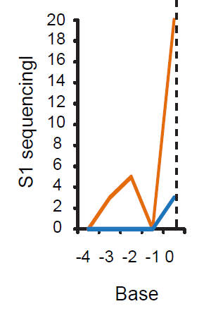

PARS identified RiboSNitches can be validated by allele specific mapping
A
65% of identified RiboSNitches
can be validated by allele specific mapping from in Vivo PARS
C
Wan & Qu et al Nature 2014

Slide 31
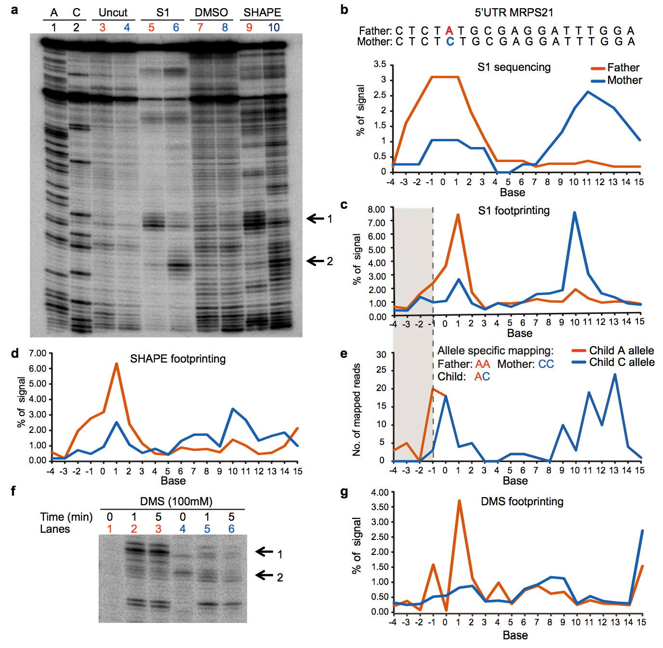
RiboSNitches can be validated using RNA footprinting
Wan & Qu et al Nature 2014
Notes:
Show me the gel. We validated 9 out of 10 RiboSNitches

Slide 32
Any characteristics of RiboSNitches?

Slide 33
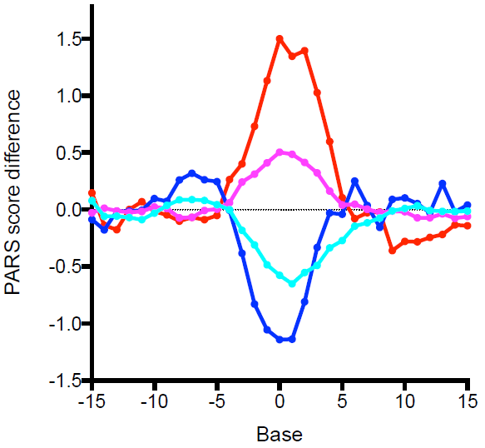


Nucleotide content influences the direction of structural changes
A/T
G/C
G/C
A/T
Wan & Qu et al Nature 2014

Slide 34
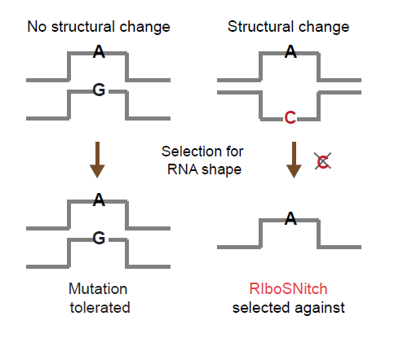
RiboSNitches are depleted from functional regions in the transcriptome
Wan & Qu et al Nature 2014

Slide 35
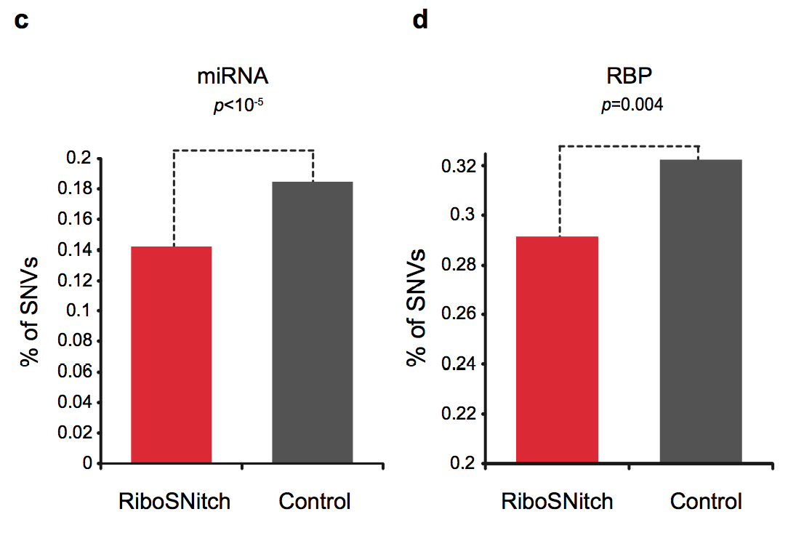
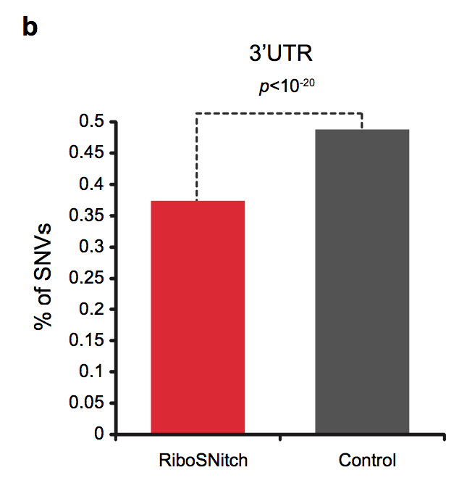
RiboSNitches are depleted from functional regions in the transcriptome
Wan & Qu et al Nature 2014

Slide 36
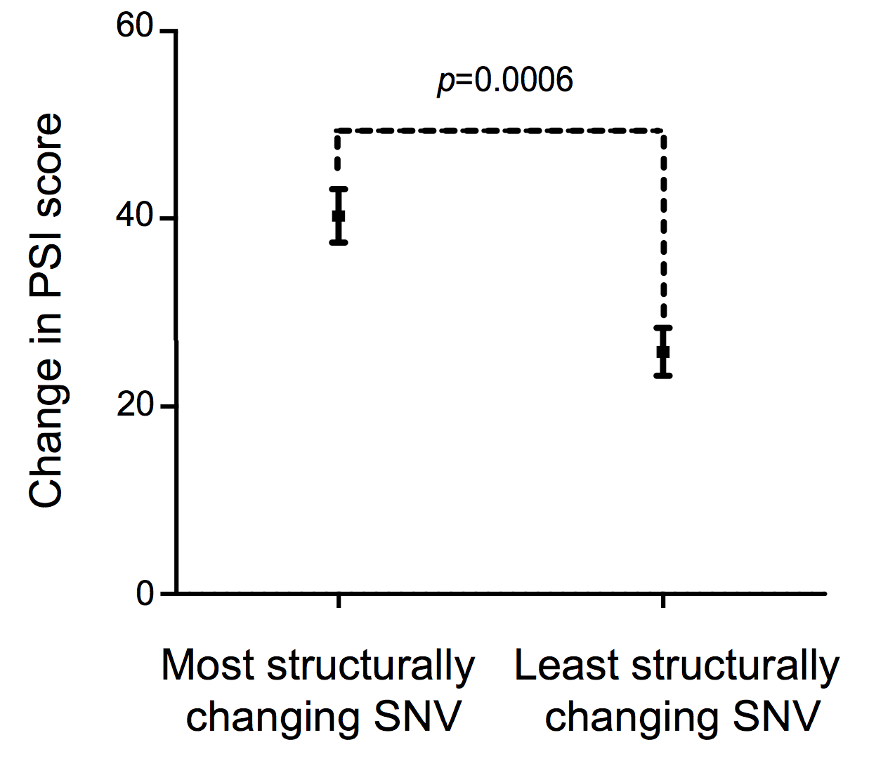
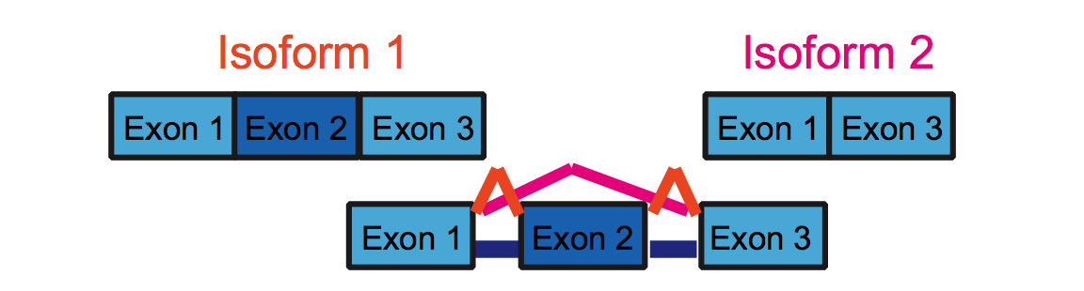
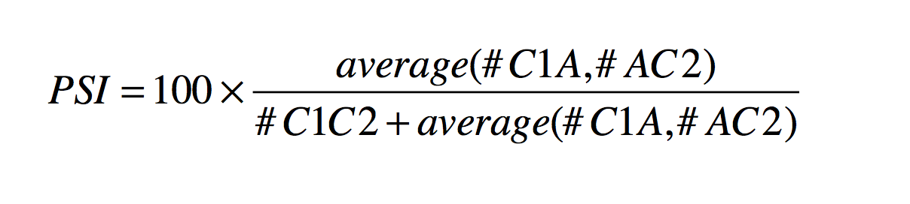
RiboSNitches may play a role in influencing alternative splicing
C1
A
C2
Wan & Qu et al Nature 2014

Slide 37
Other methods to identify RNA structure in vivo?

Slide 38
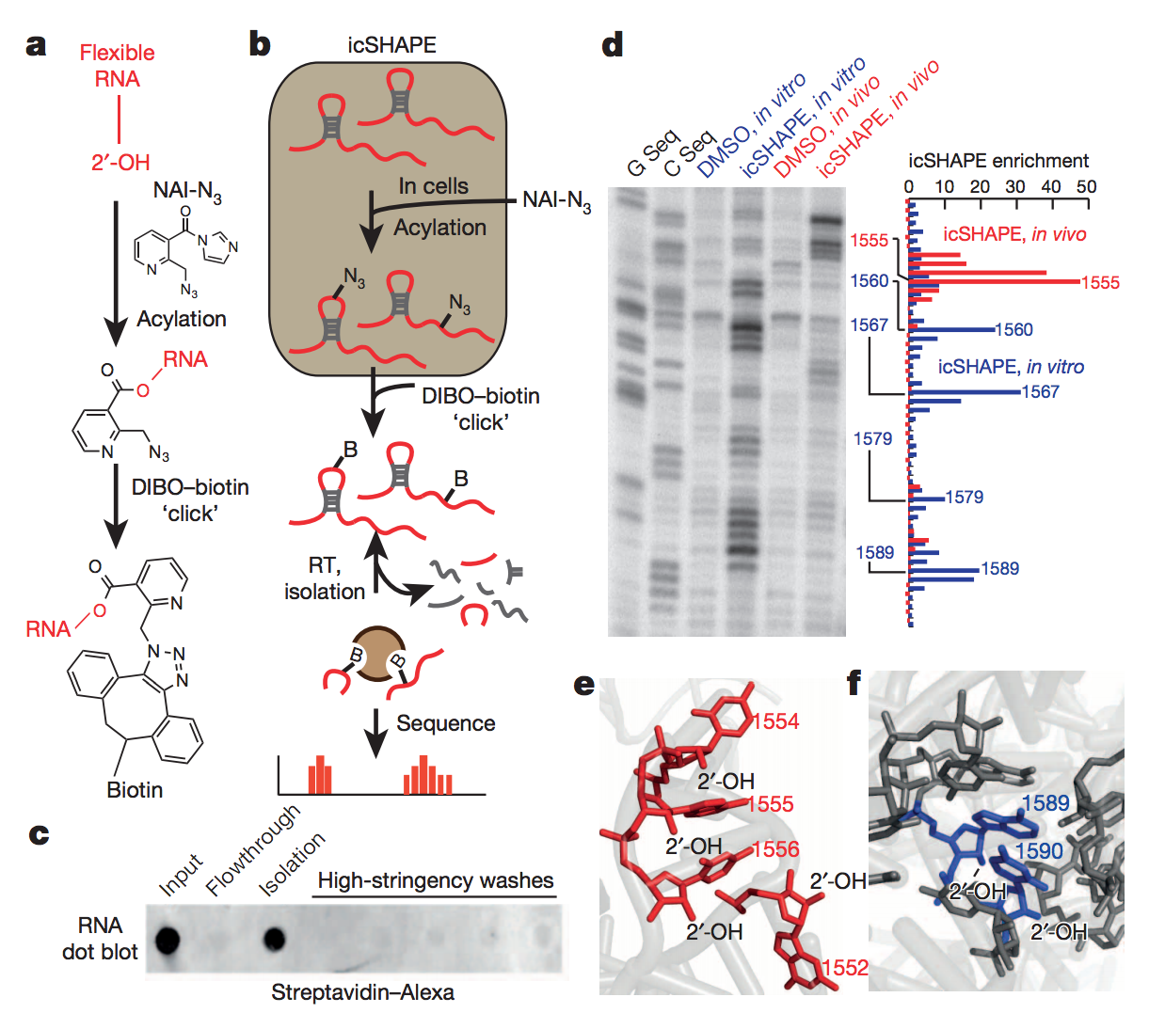
icSHAPE is a novel and robust method for measuring RNA structure

Slide 40
Name: Date:
1. List two genome-wide RNA structure probing techniques?
2. Which type of the following RNA is MOST thermodynamically stable in terms of structure? mRNA, lncRNA or rRNA.
3. Which end of mRNA is more thermodynamically stable? The 3’end or 5’end.
4. Why do we care about RNA structure? Please list at least two reasons.

