Slide 1
Protein-DNA/RNA interaction (ChIP-seq, CLiP-seq)
How to identify protein-DNA/RNA interacted sites?
How does a protein recognize its DNA/RNA biding sites?
Discussion:
How to build up a regulatory network?
Limitations of motif based analysis?

Slide 2
Protein-DNA/RNA interaction

Slide 3
How to identify protein-DNA/RNA interacted sites?
How does a protein recognize its DNA/RNA biding sites?
Notes:
I was not trained as a biologist, and the central dogma was almost the only thing I knew in modern biology.
RNA characteristics makes RNA study more challenging and thus more interesting.
Instead of a liner structure, they all seems to work together for a particular function.
Get a figure for X-inactivation.
We noticed that other than the sequencing of the RNAs, one of a key factor that affects RNA in functioning in all these processes is its SHAPE

Slide 4
Chromatin immunoprecipitation experiments followed by sequencing (ChIP–seq) detect protein–DNA binding events and chemical modifications of histone proteins.
Dr. Keji Zhao @ NIH
-Mikkelsen et al. from the Broad submitted to Nature and was published in August, 2007 -Johnson et al. from Stanford submitted to Science and was published in June, 2007 -Barski et al. from NHLBI, NIH submitted to Cell and was published in May, 2007

Slide 5
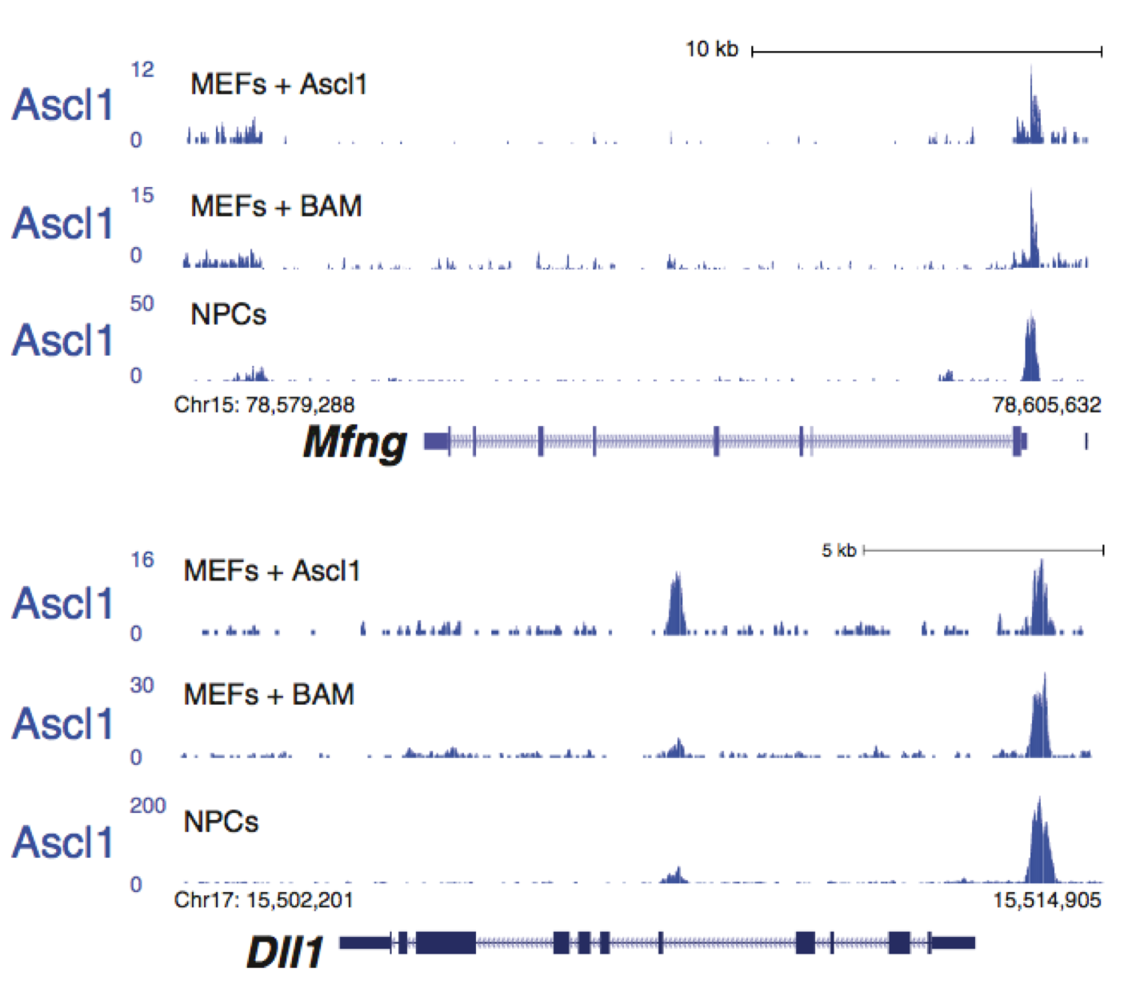
Typical TF ChIP-seq signal
Wapinski et al, Cell, 2013

Slide 6
Prof. Zhang Yong
@ Tongji University
Prof. Shirley Liu
@ Harvard University

Slide 7
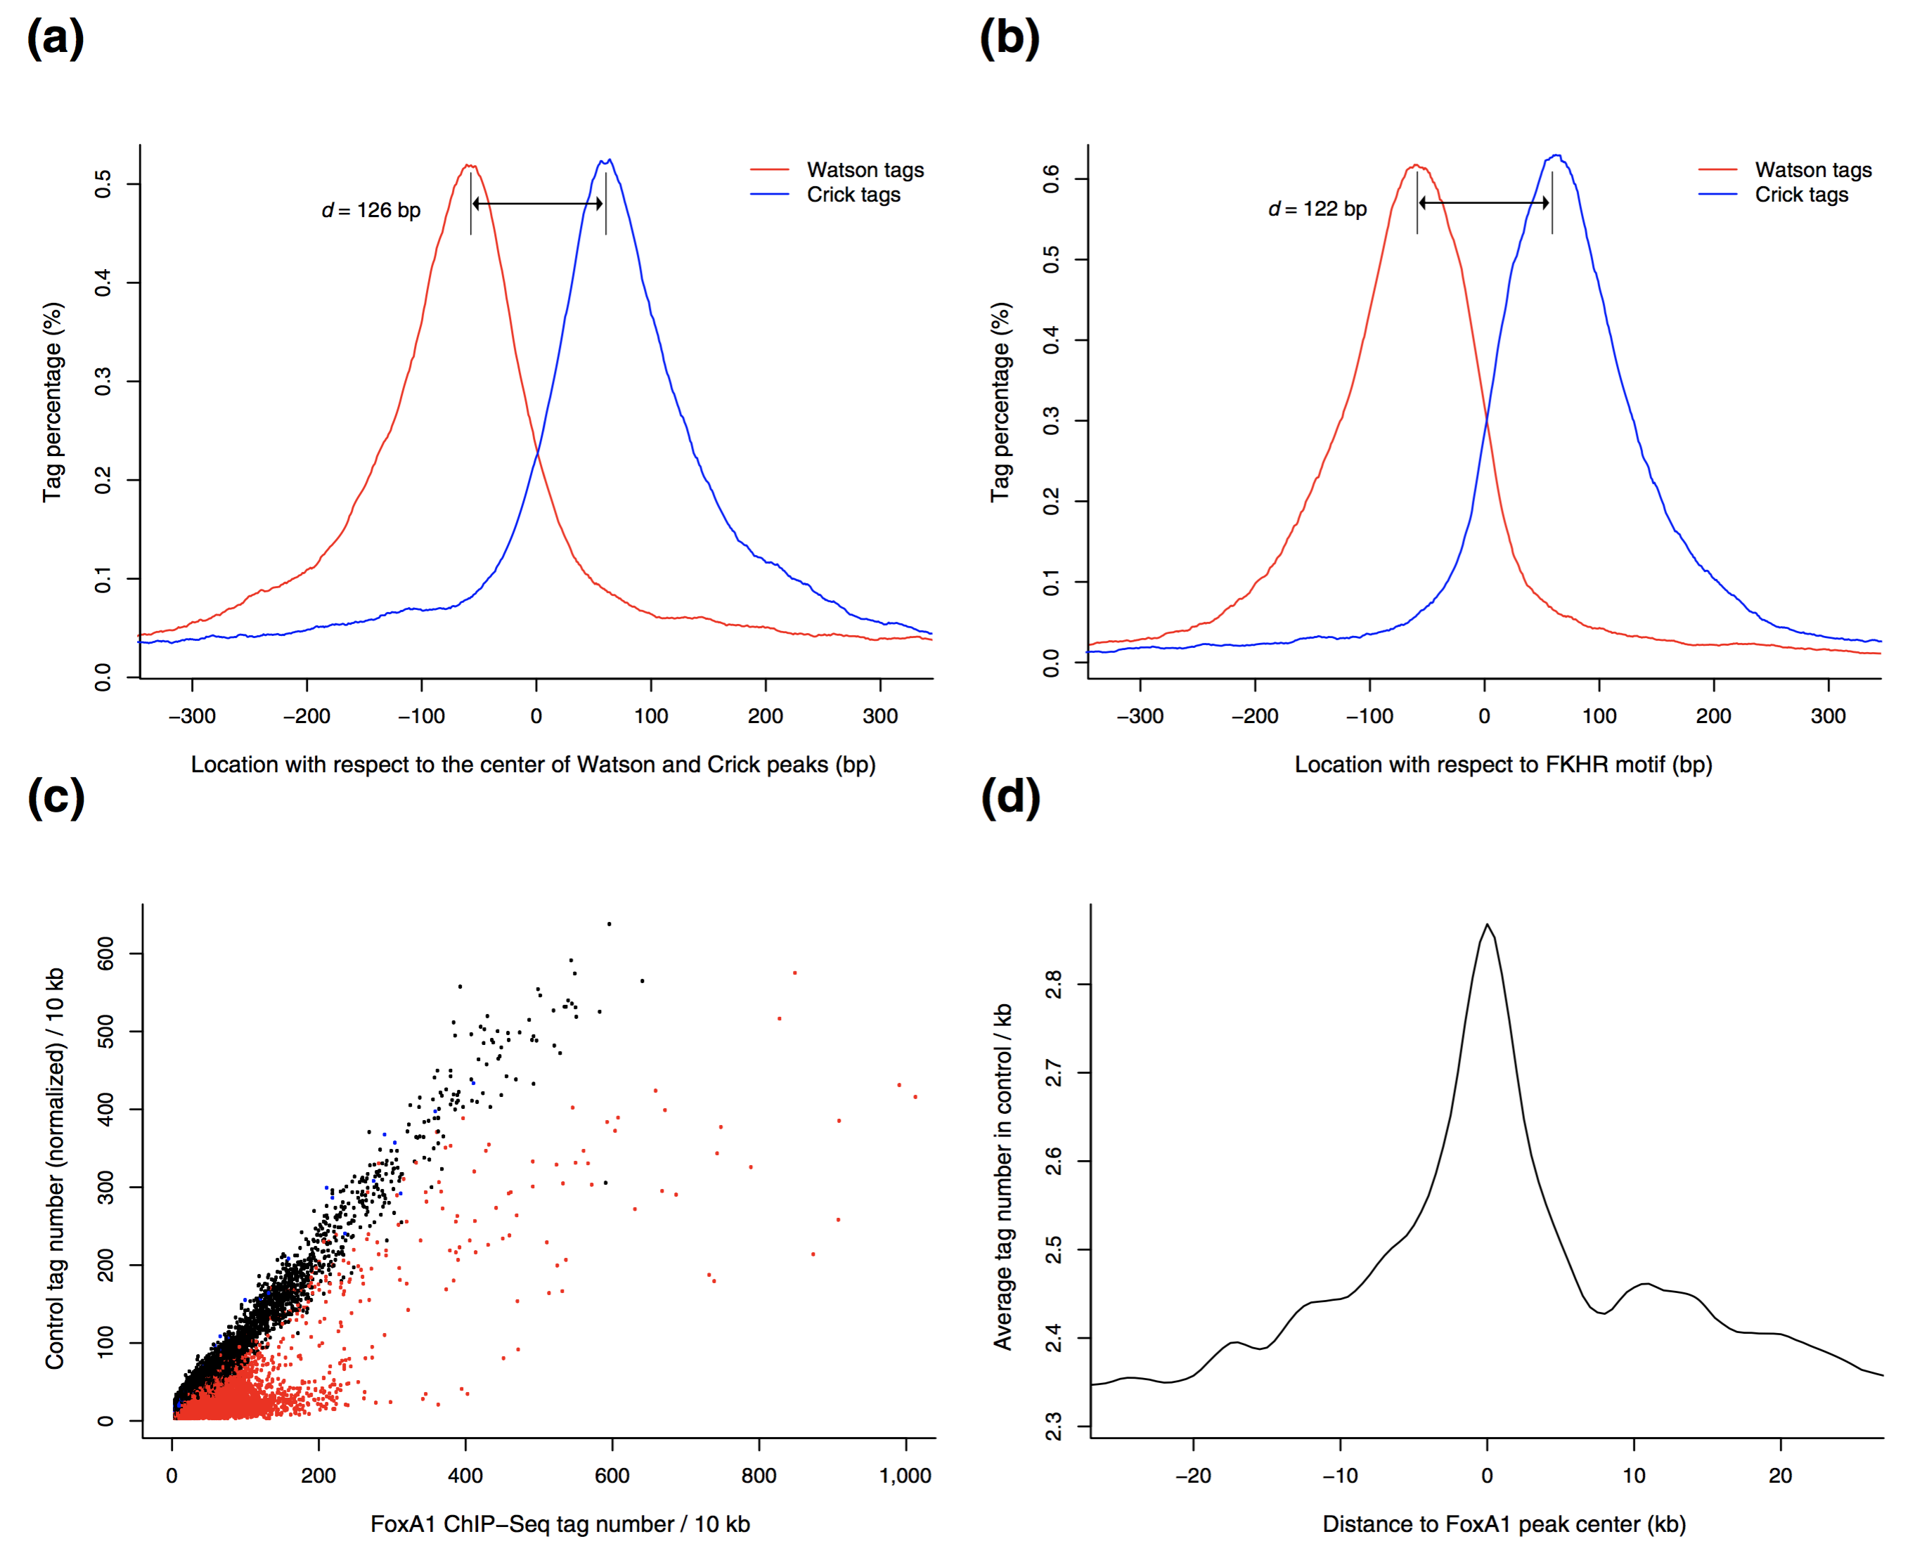

Slide 8
Limitations of MACS?
How to check ChIP-seq data reproducibility?
Peak = Protein-DNA binding?

Slide 9
Protein-RNA interaction
RNA Immunoprecipitation followed by high-throughput sequencing
(RIP-seq)
Crosslinking-immunoprecipitation
(CLiP-seq)

Slide 10
Difference between ChiP-seq and RIP/CLiP-seq
data analysis?
Difference between RIP-seq and CLiP-seq
data analysis?

Slide 11
What is DNA sequencing motif?

Slide 12
Sequencing motif search using MEME Suite

Slide 14
What can we do if we know ALL TF motifs?

Slide 15
How about create a regulatory network?

Slide 16
What if there is no Sequence motif?

